Slide 1


CRL ray tracing, error simulations, wavefront propagation (SRW, HYBRID)
Rafael Celestre
rafael.celestre@synchrotron-soleil.fr
Groupe Optique, Division Expériences, Synchrotron SOLEIL
Luca Rebuffi
lrebuffi@anl.gov
Optics Group, Advanced Photon Source

Slide 2
CRL ray tracing, error simulations, wavefront propagation
Outline:
X-ray lens modelling
Why x-ray lens modelling?
Accurate simulation of x-ray lenses and CRL
Live demo using OASYS

Slide 3
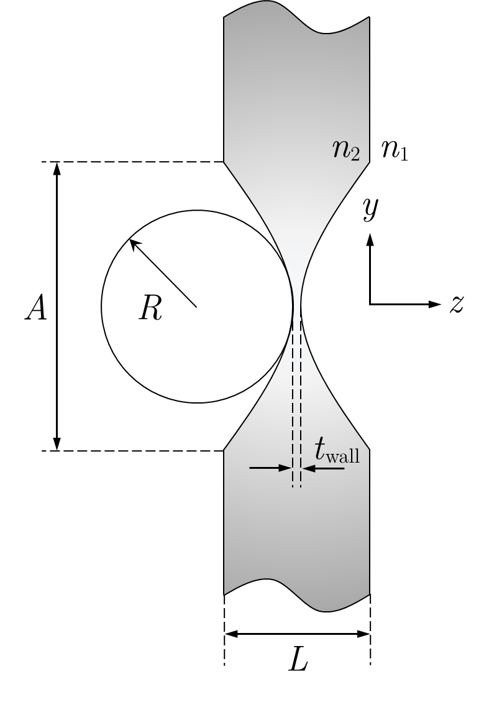
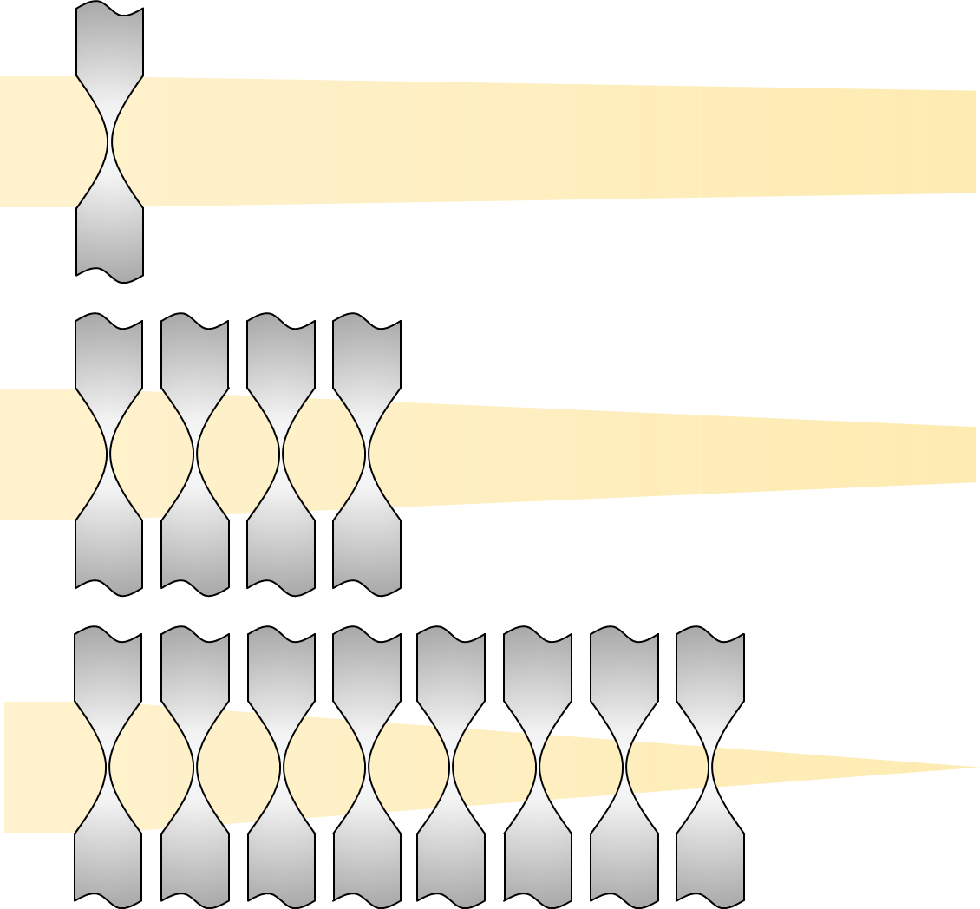
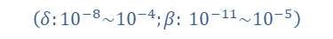

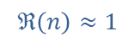
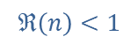
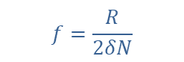
X-ray lens modelling
$$n=1−δ+i⋅β$$
$$ℜ\left(n\right)<1$$
$$ℜ\left(n\right)≈1$$
$$f=\frac{R}{2δN}$$
(left) sagittal cut of an x-ray lens; (right) stacking of lenses to reduce the focal length of the CRL
$\left(δ:{10}^{−8}\sim {10}^{−4};β: {10}^{−11}\sim {10}^{−5}\right)$

Slide 4
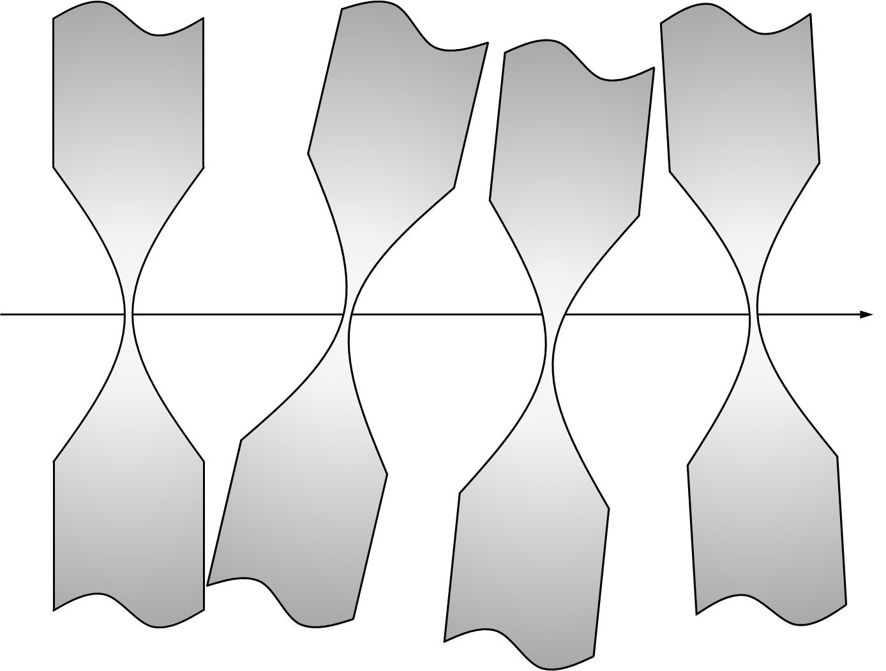
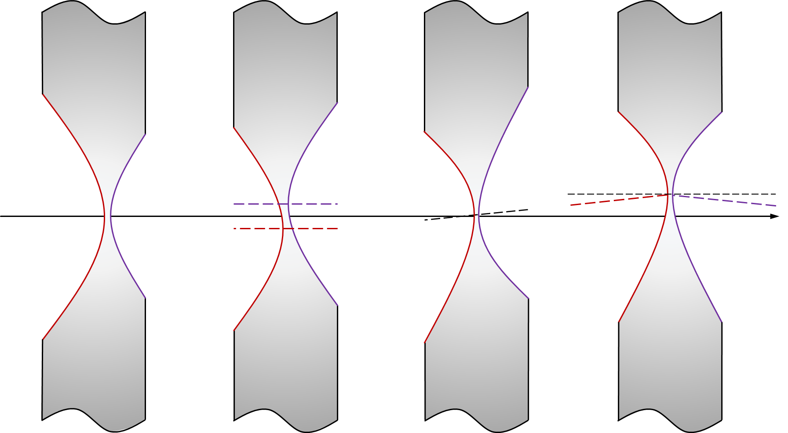
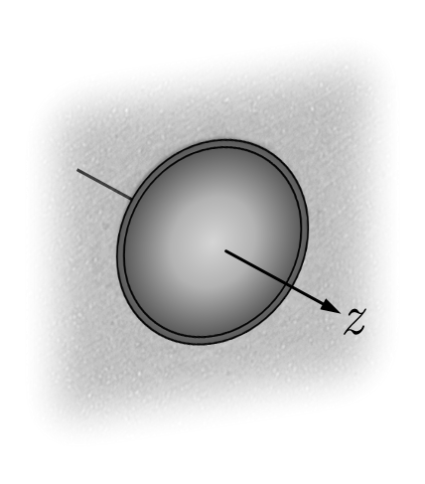
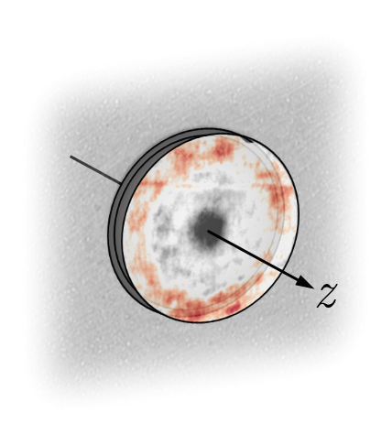
X-ray lens modelling
The complex transmission operator representing a single x-ray lens:
$$T_{x−ray lens}\left(x,y\right)• =\exp\left[−kβ⋅Δ_{x−ray lens}\left(x,y\right)\right]⋅\exp\left[−ikδ{⋅Δ}_{x−ray lens}\left(x,y\right)\right]•$$
(left) typical lens misalignment; (middle) idealised lens fabrication errors; (right) lens with metrology data added to it
$$T_{imperfect lens}\left(x,y\right)• =T_{figure error}\left(x,y\right)⋅T_{ideal lens}\left(x,y\right)•$$

Slide 5
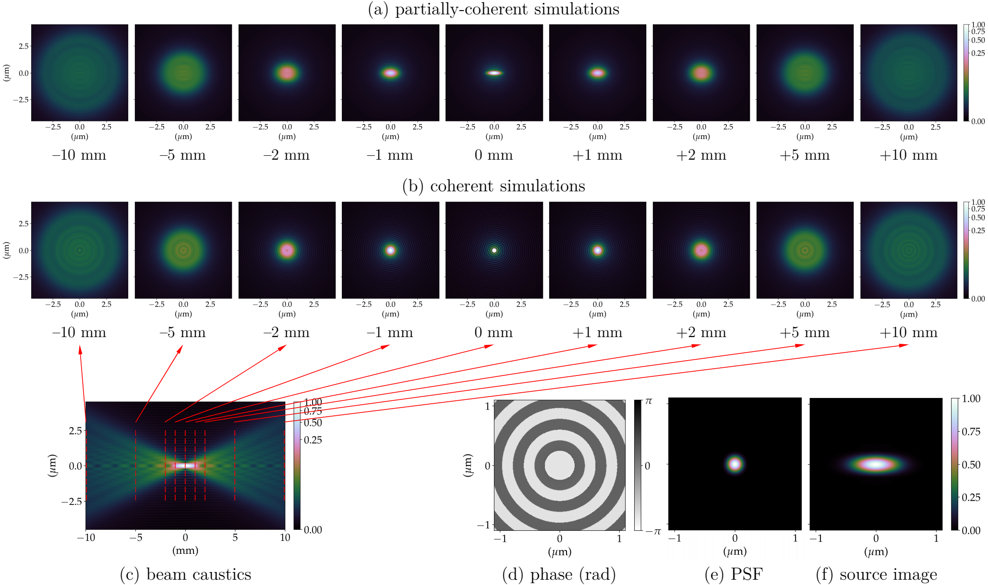
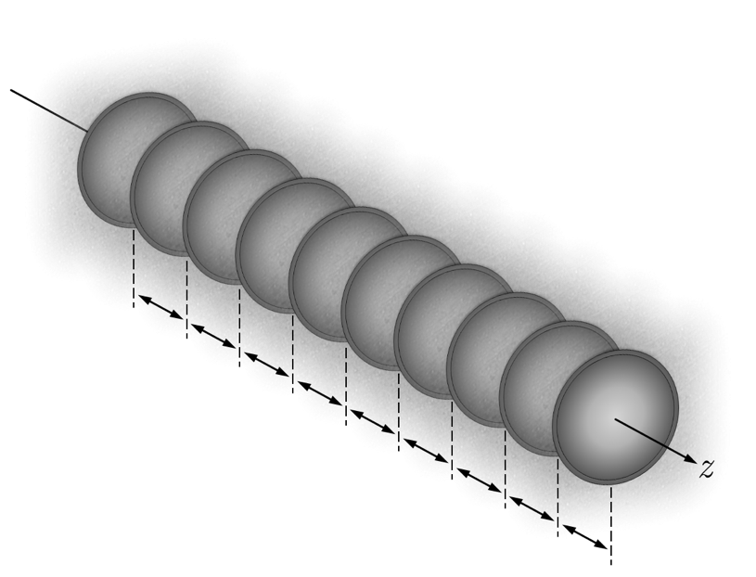
X-ray lens modelling
R. Celestre et al, J. Synch. Rad. 27(2), 305 (2020)

Slide 6
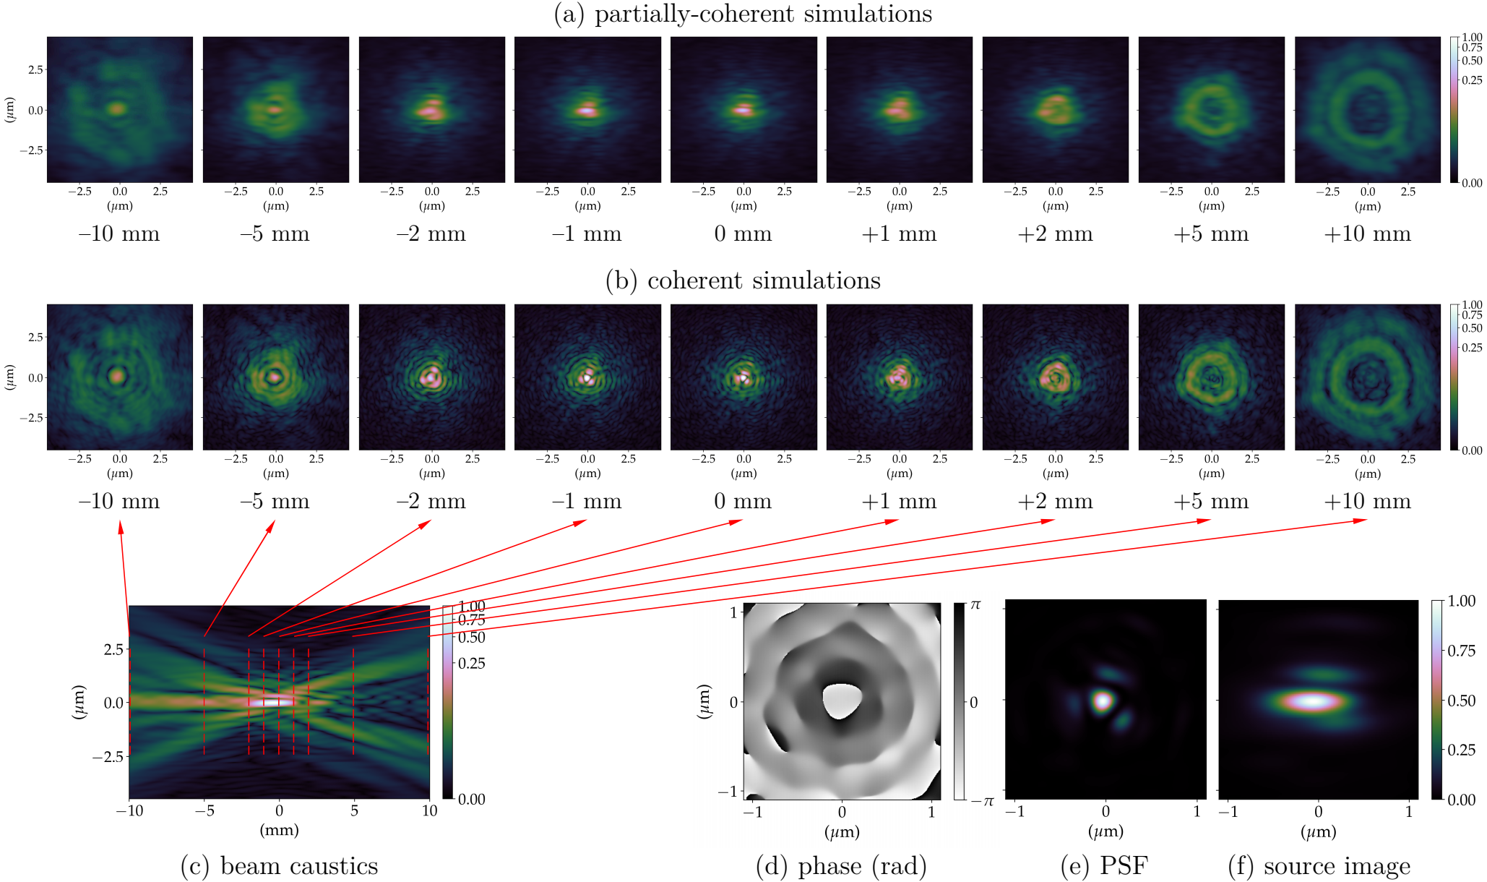
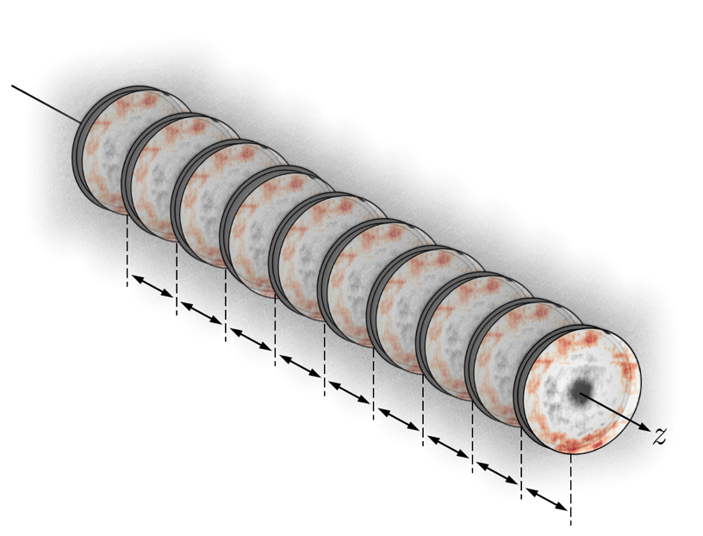
X-ray lens modelling
R. Celestre et al, J. Synch. Rad. 27(2), 305 (2020)

Slide 7
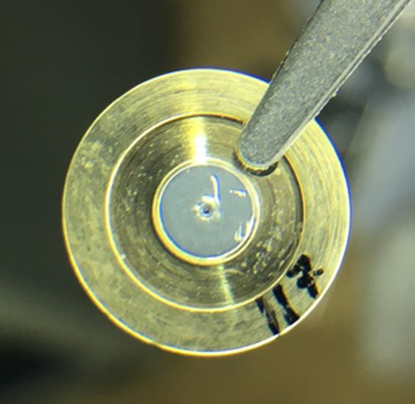
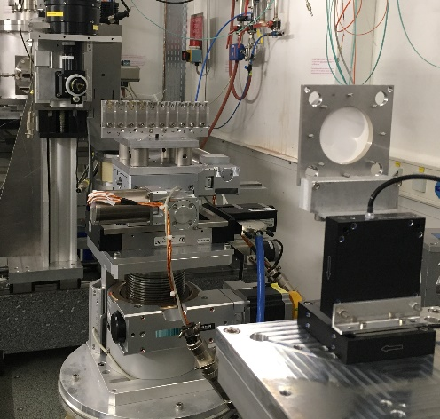
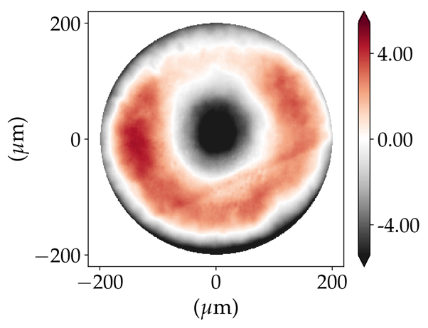
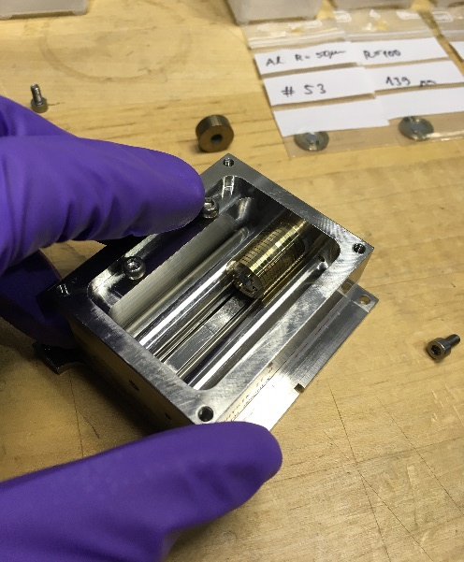
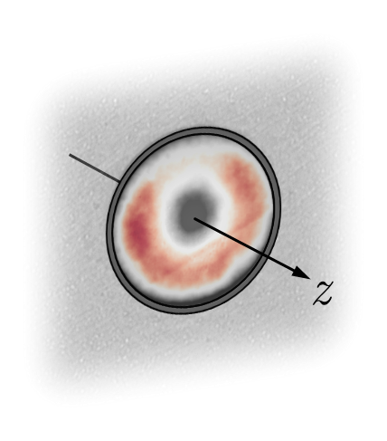
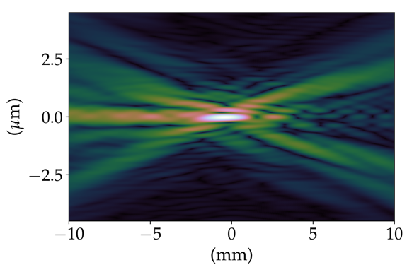
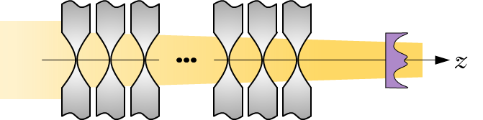
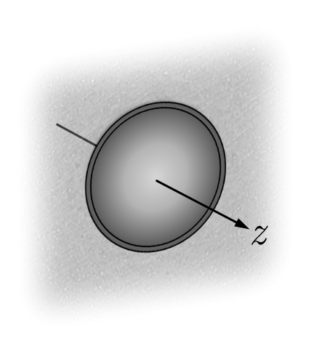
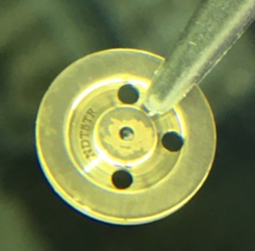
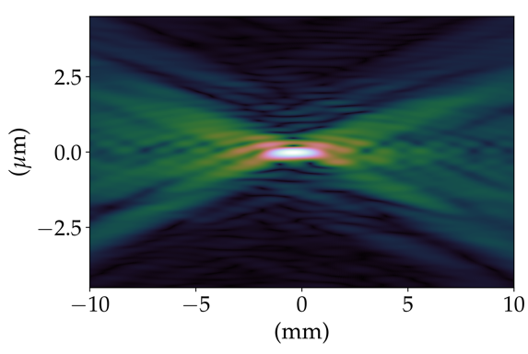
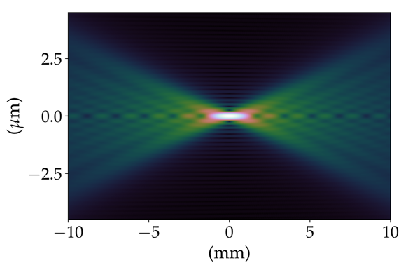
Why x-ray lens modelling?
(a) lens (stack)
(b) at-wavelength metrology
(c) error profile
(d) “realistic” modelling
(f) manufactured correction
(e) ideal modelling

Slide 8
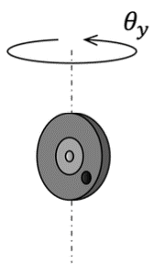
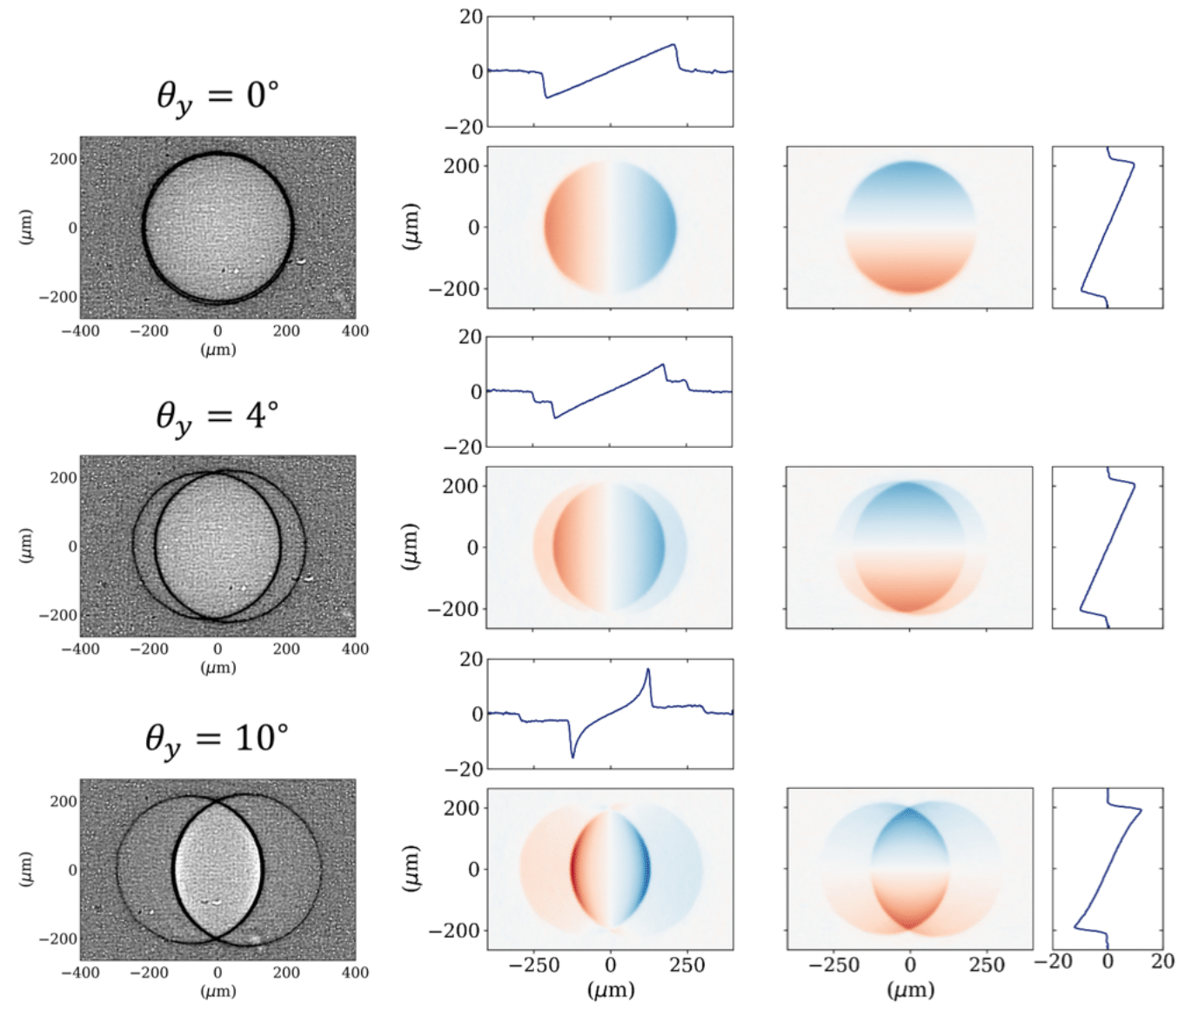
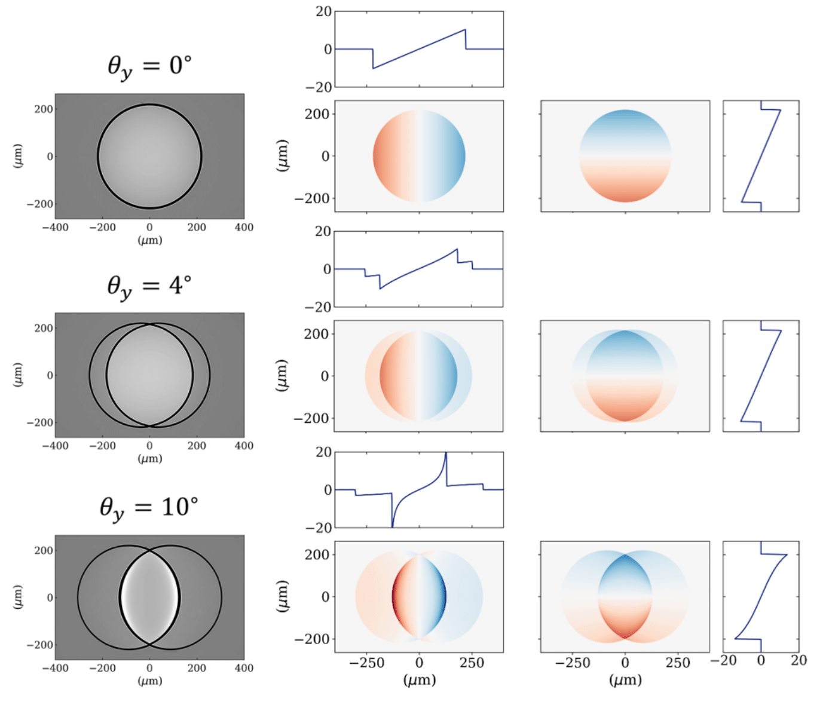
Accurate simulation of x-ray lenses and CRL - I
Tilting refractive x-ray lenses for fine-tuning of their focal length
(a) experimental data (radiograph and wavefront gradient)
(b) simulations using barc4ro (available through OASYS)
R. Celestre et al, Opt. Express 31(5), 7617 (2023)

Slide 9
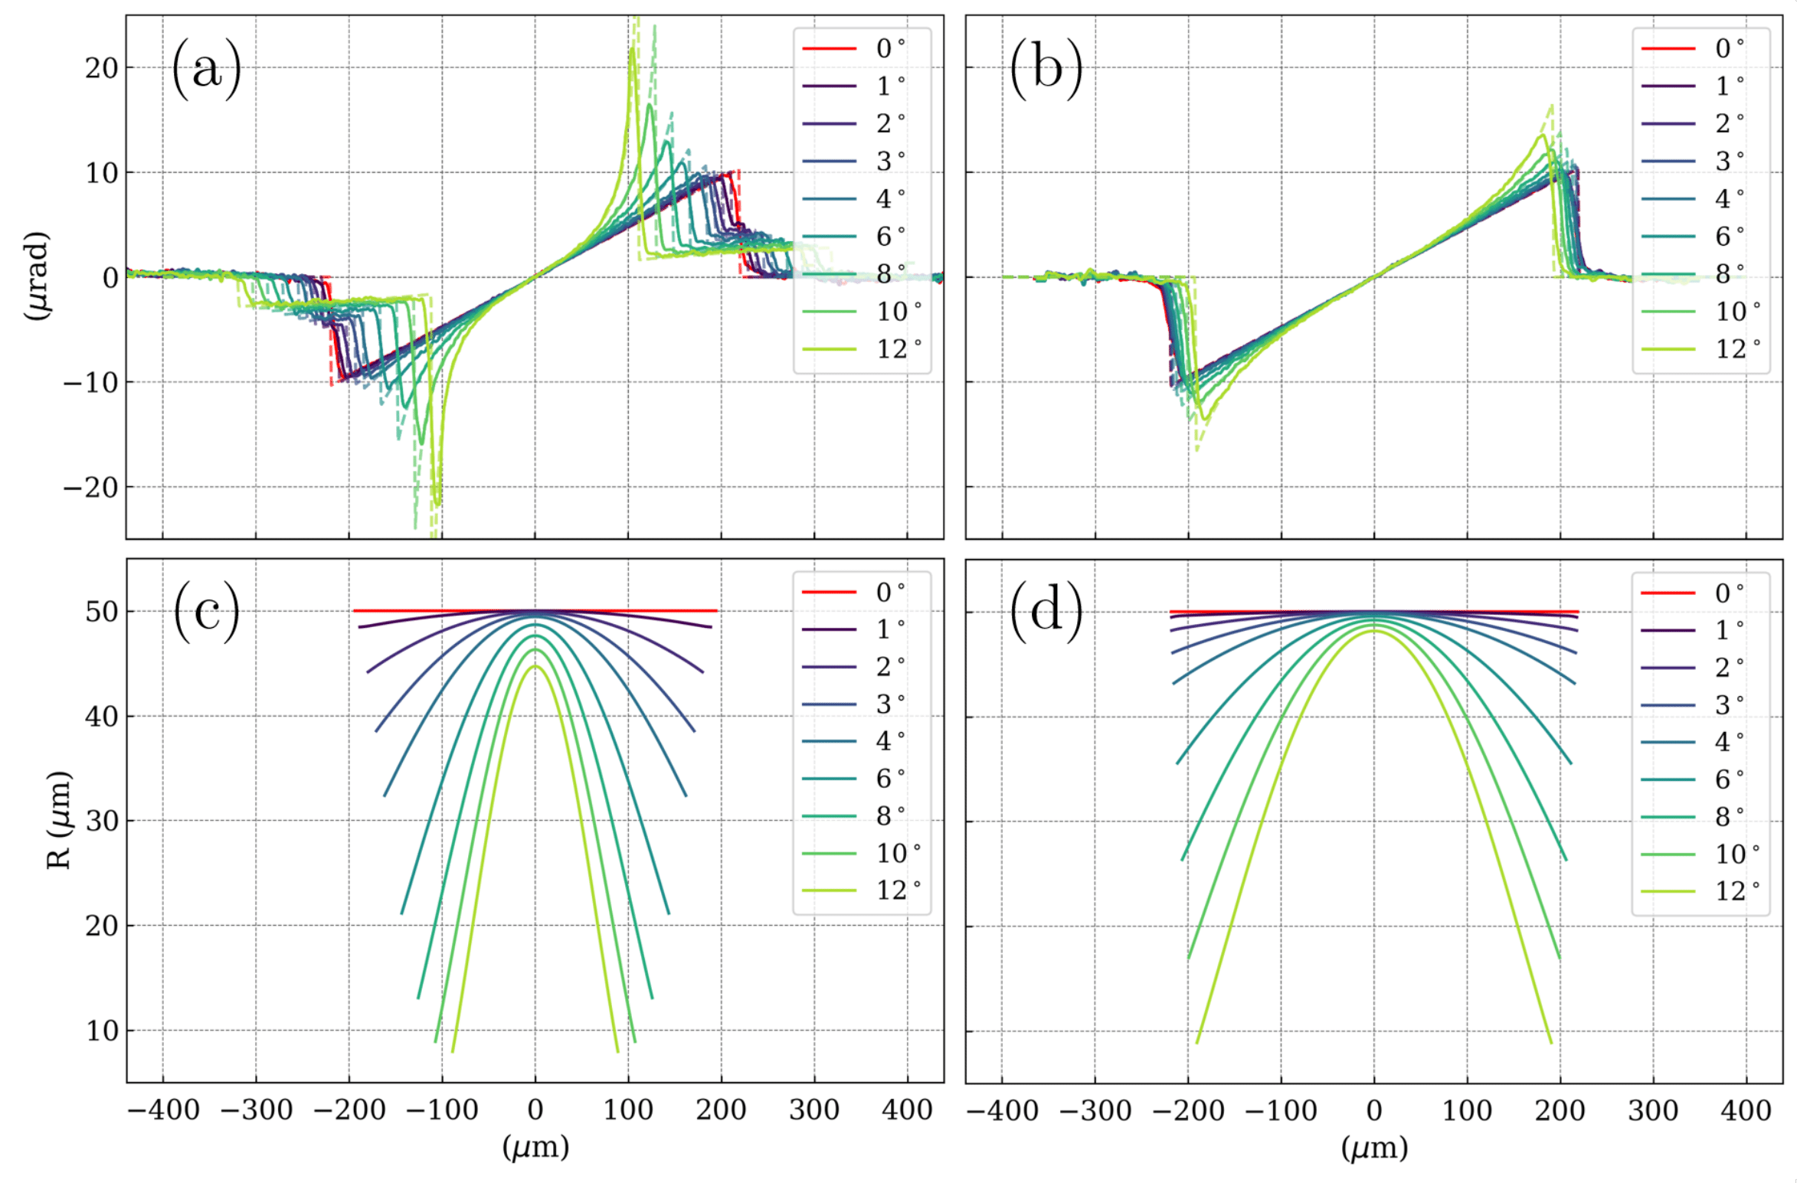
Accurate simulation of x-ray lenses and CRL - I
Tilting refractive x-ray lenses for fine-tuning of their focal length
(a) horizontal and (b) vertical gradient cuts comparison for the simulation (dashed line) and experimental data (continuous line) for a 2D Be lens with R=50 µm at E=17 keV. Calculated (c) horizontal and (d) vertical apparent radius of curvature.
R. Celestre et al, Opt. Express 31(5), 7617 (2023)

Slide 10
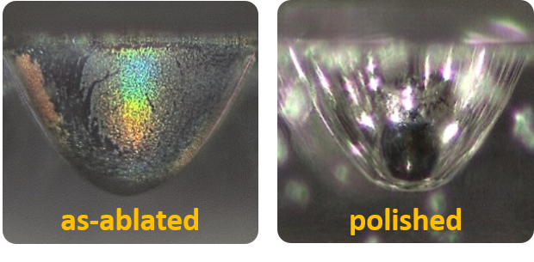
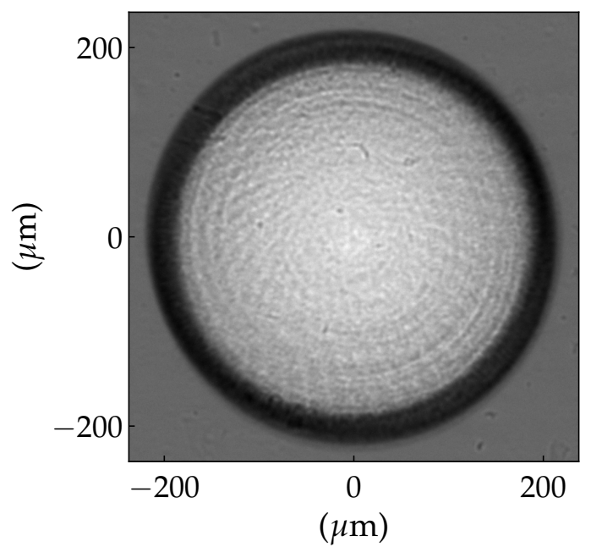
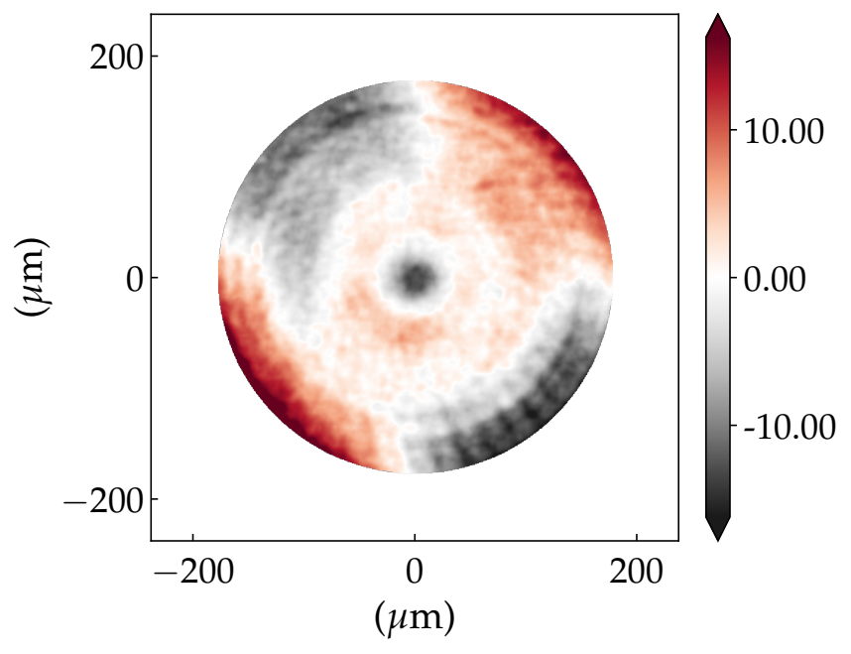
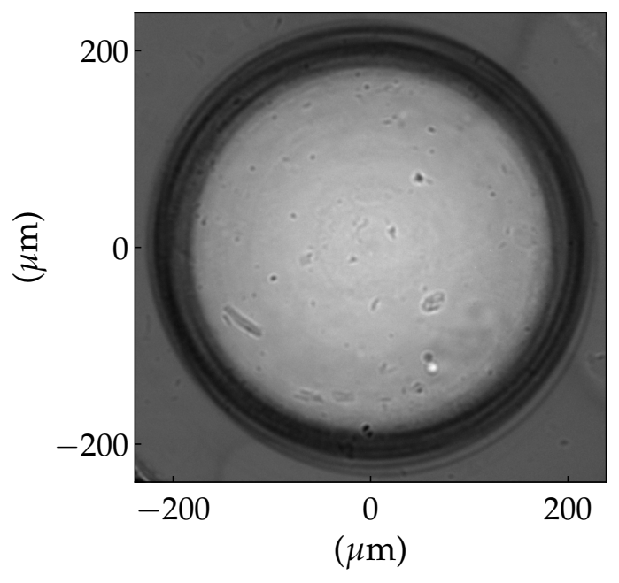
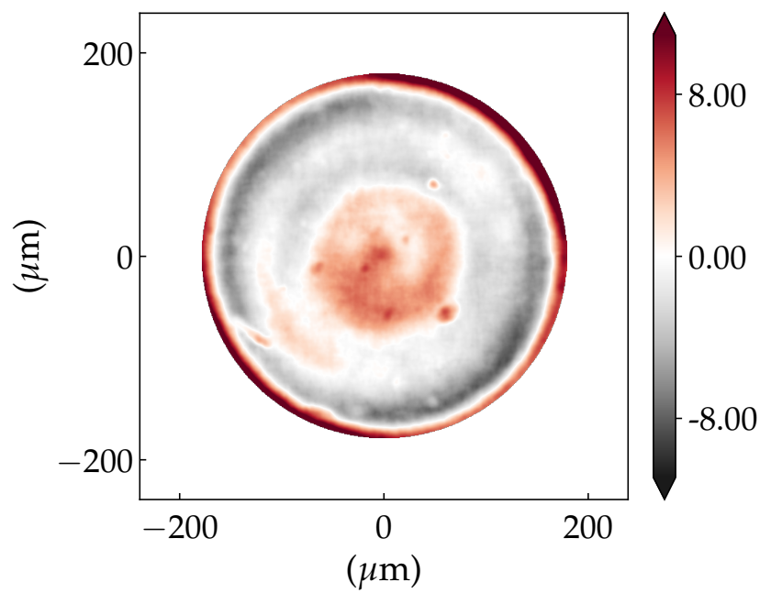
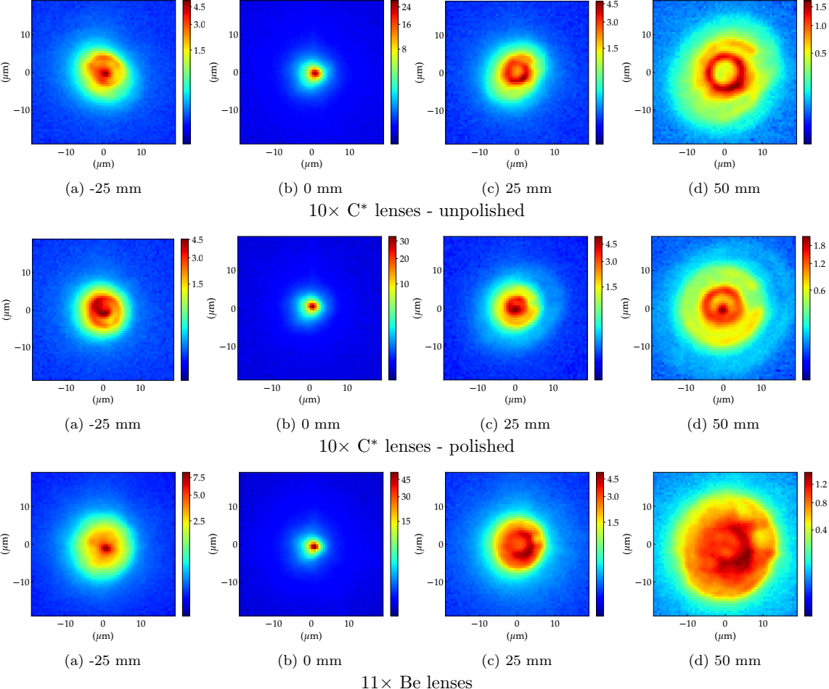
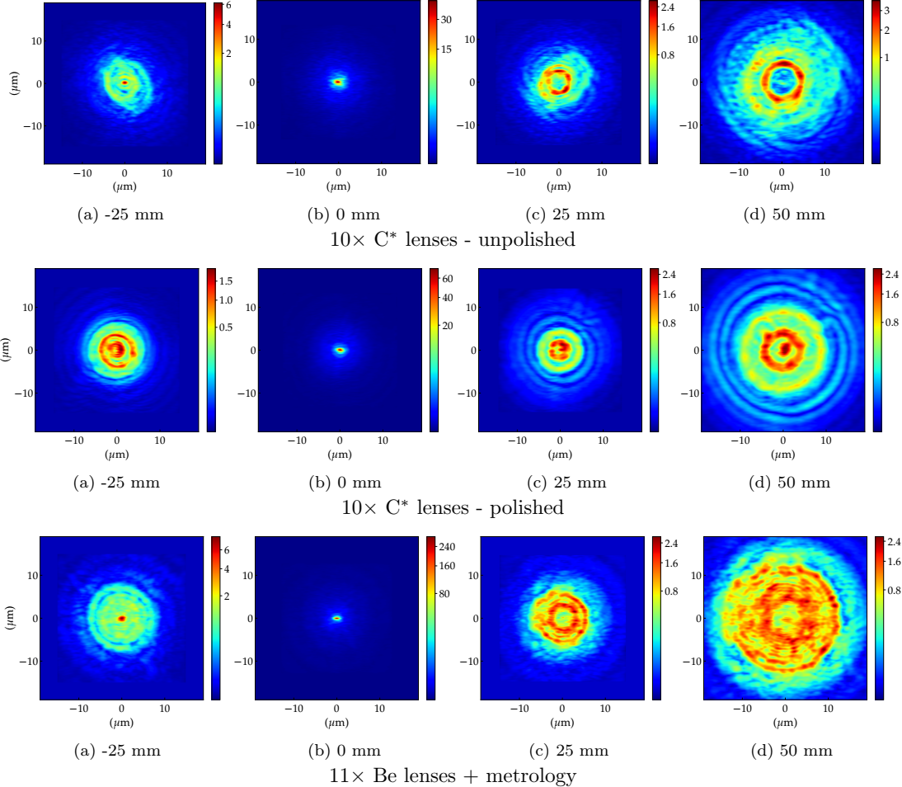
Accurate simulation of x-ray lenses and CRL - II
Partially coherent simulations of 10x 2D diamond lens stack focusing:
(a) unpolished stack
(b) polished stack
(c) experimental data (ID06)
(d) simulations using SRW
R. Celestre et al, J. Synch. Rad. 29(2), 629 (2022)

Slide 11
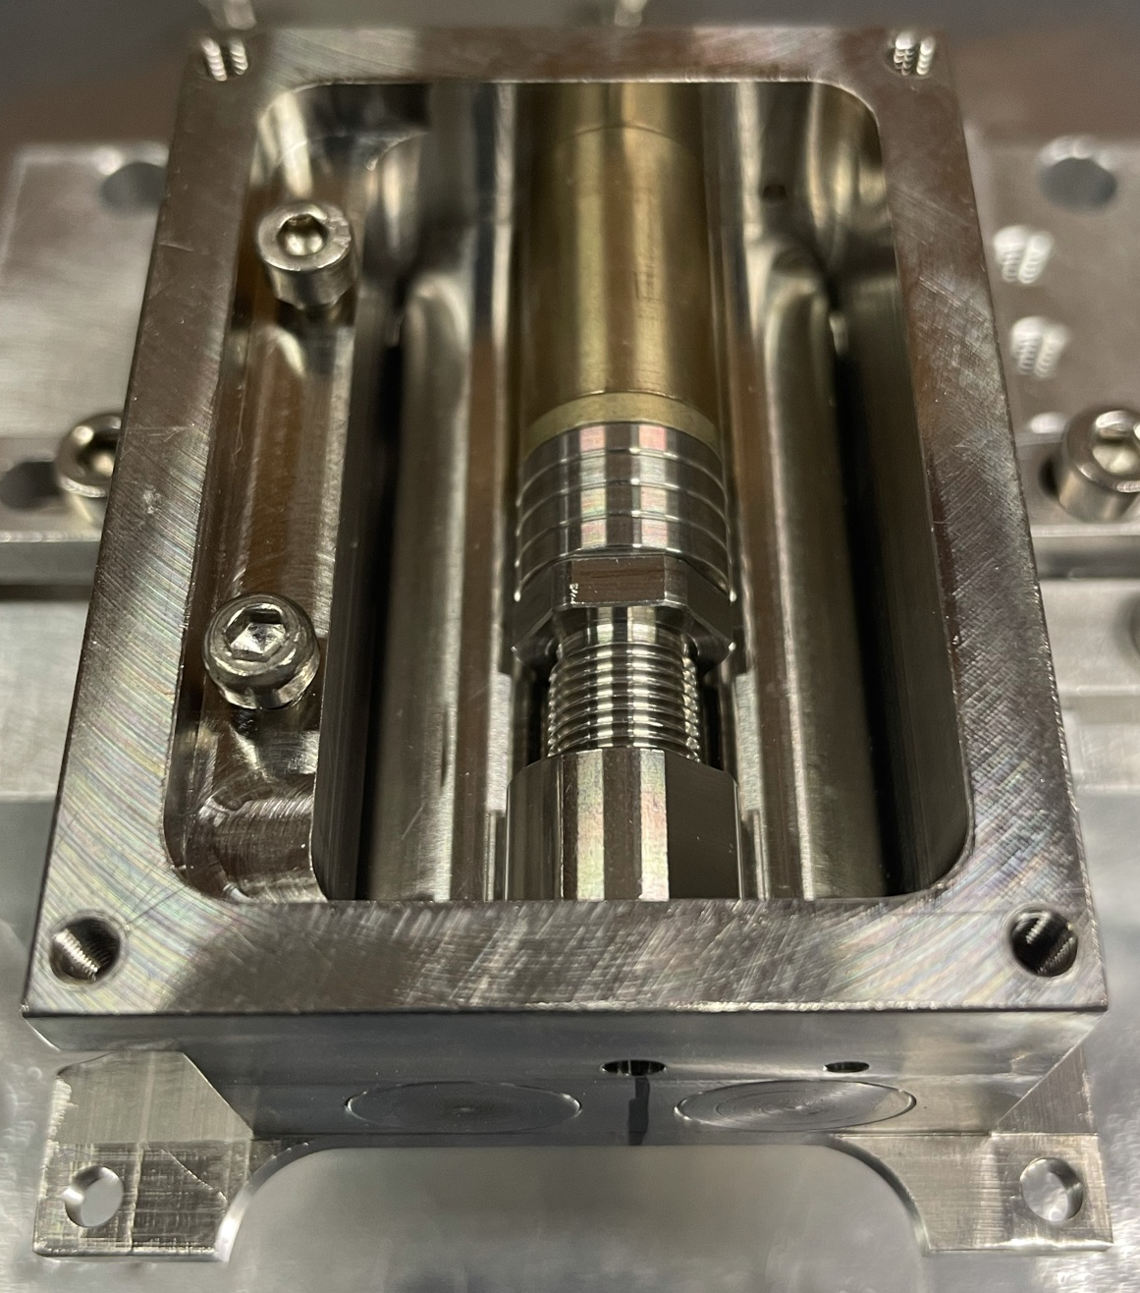
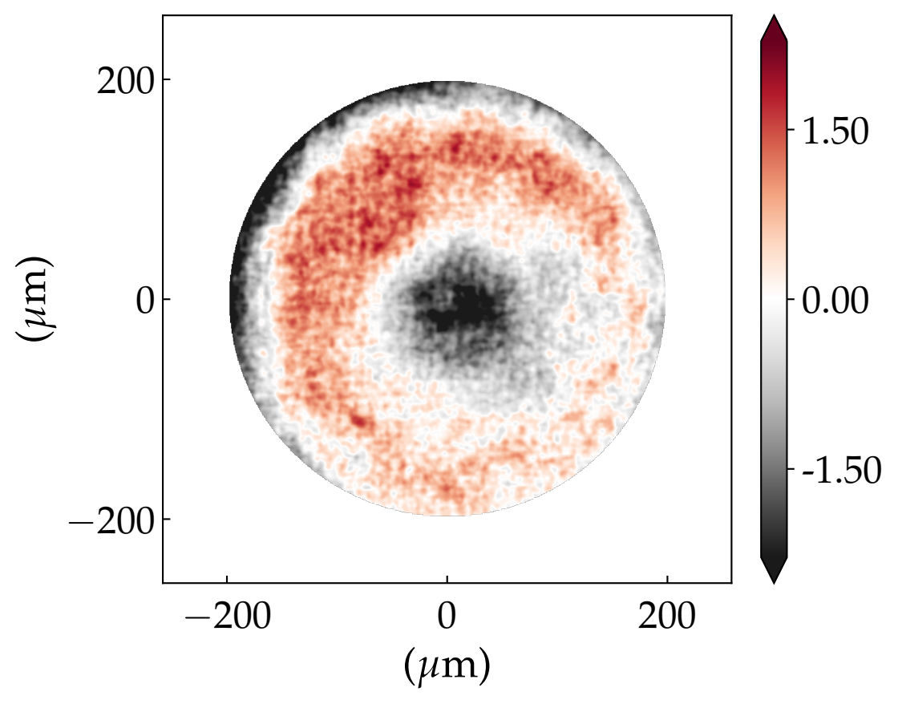
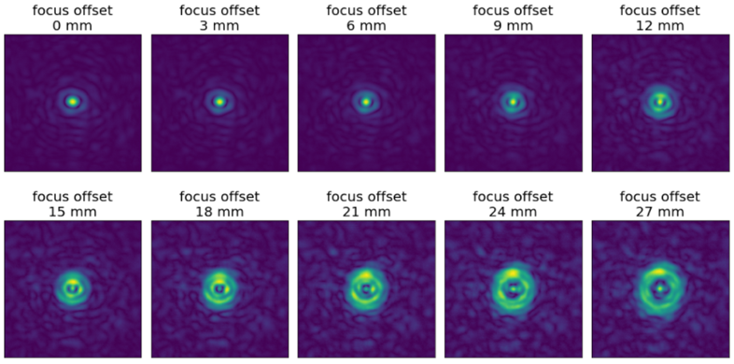
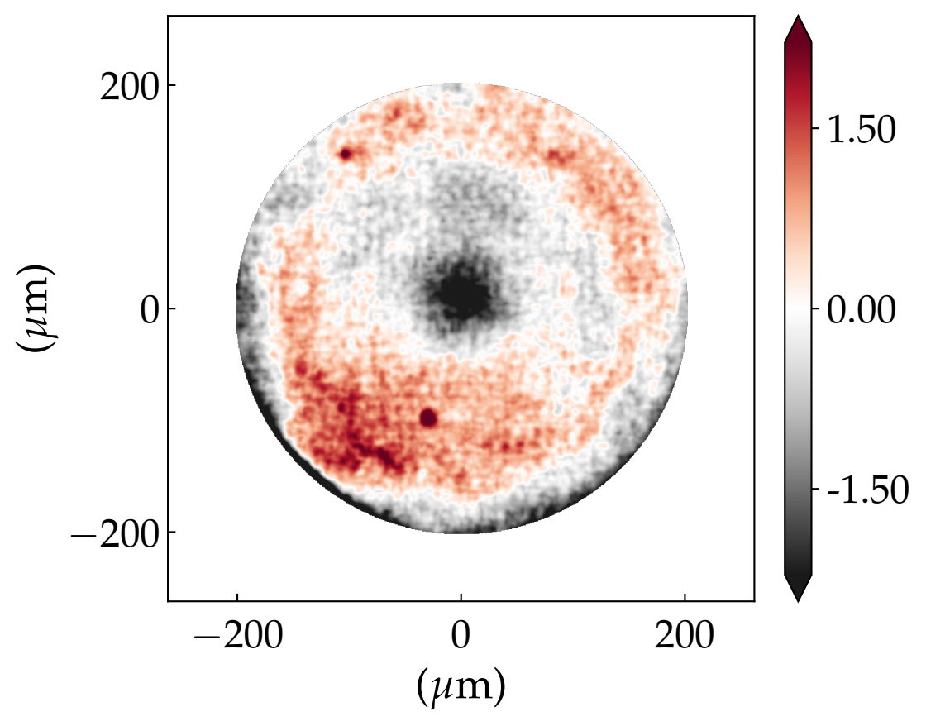
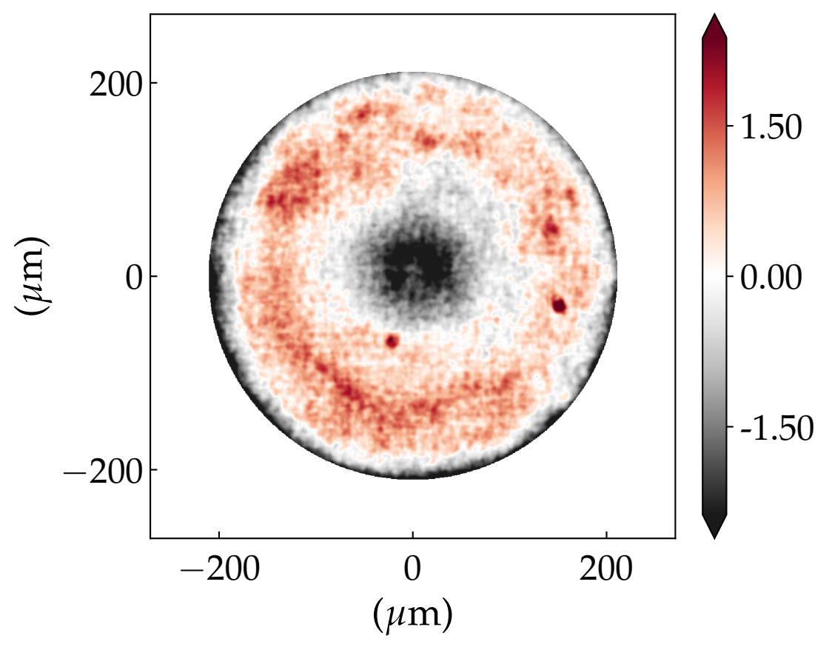
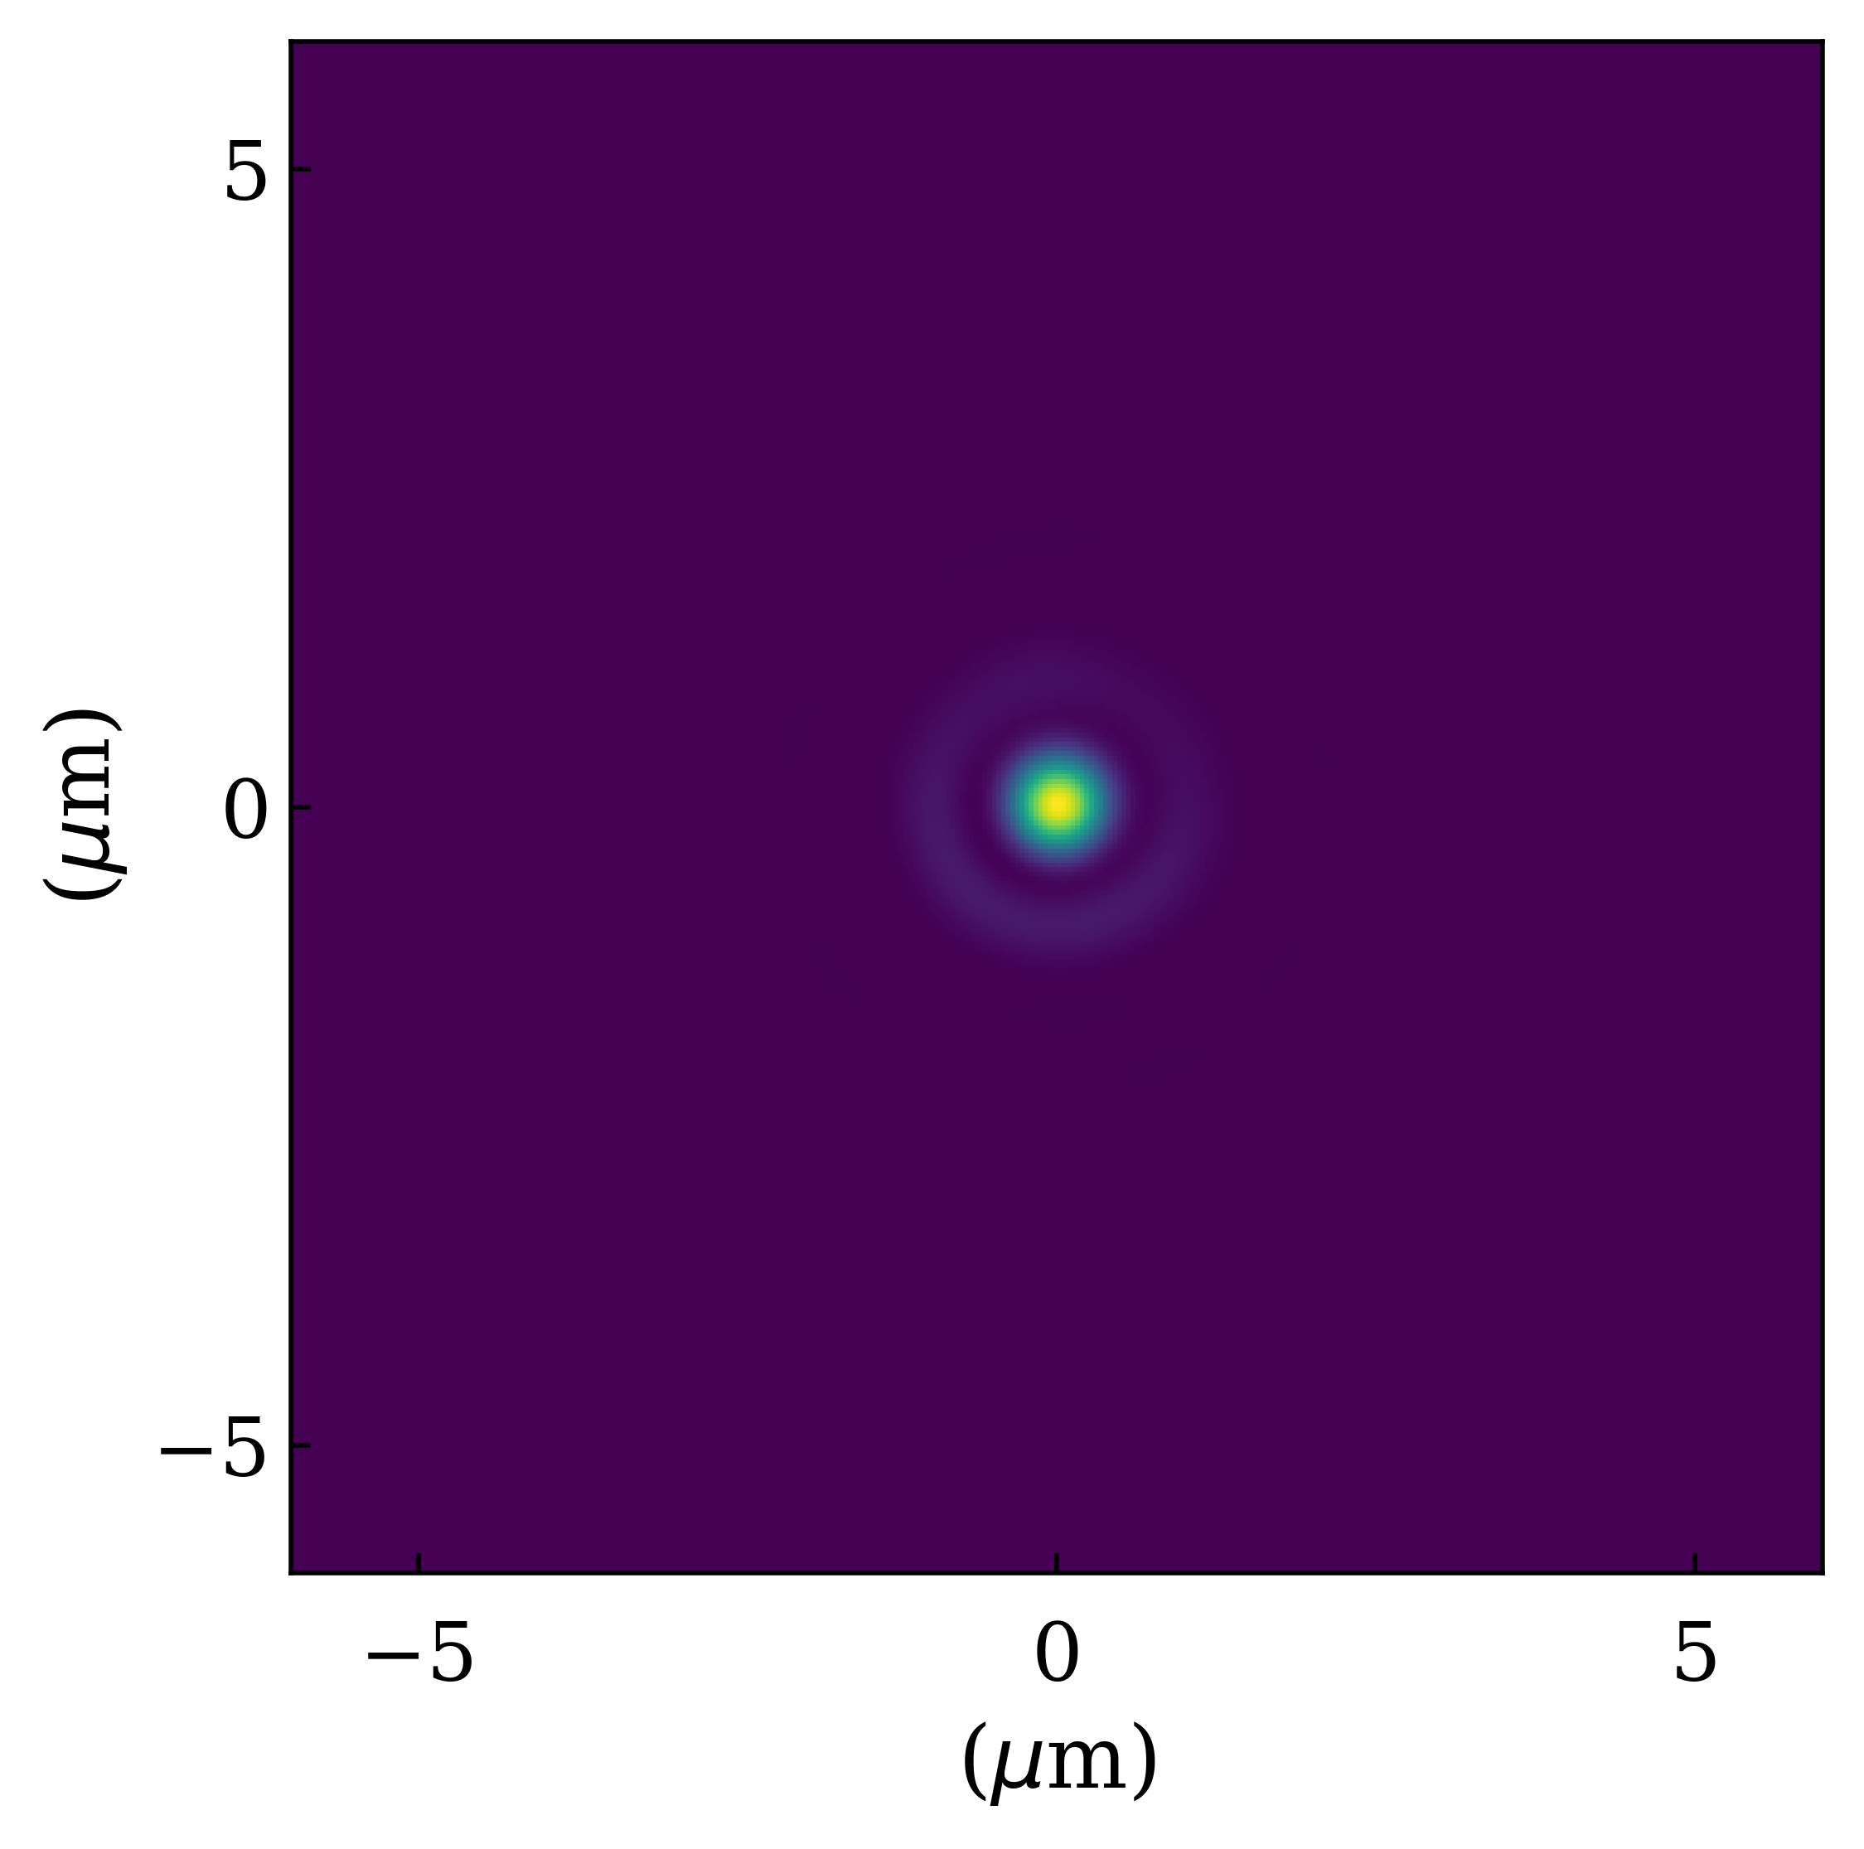
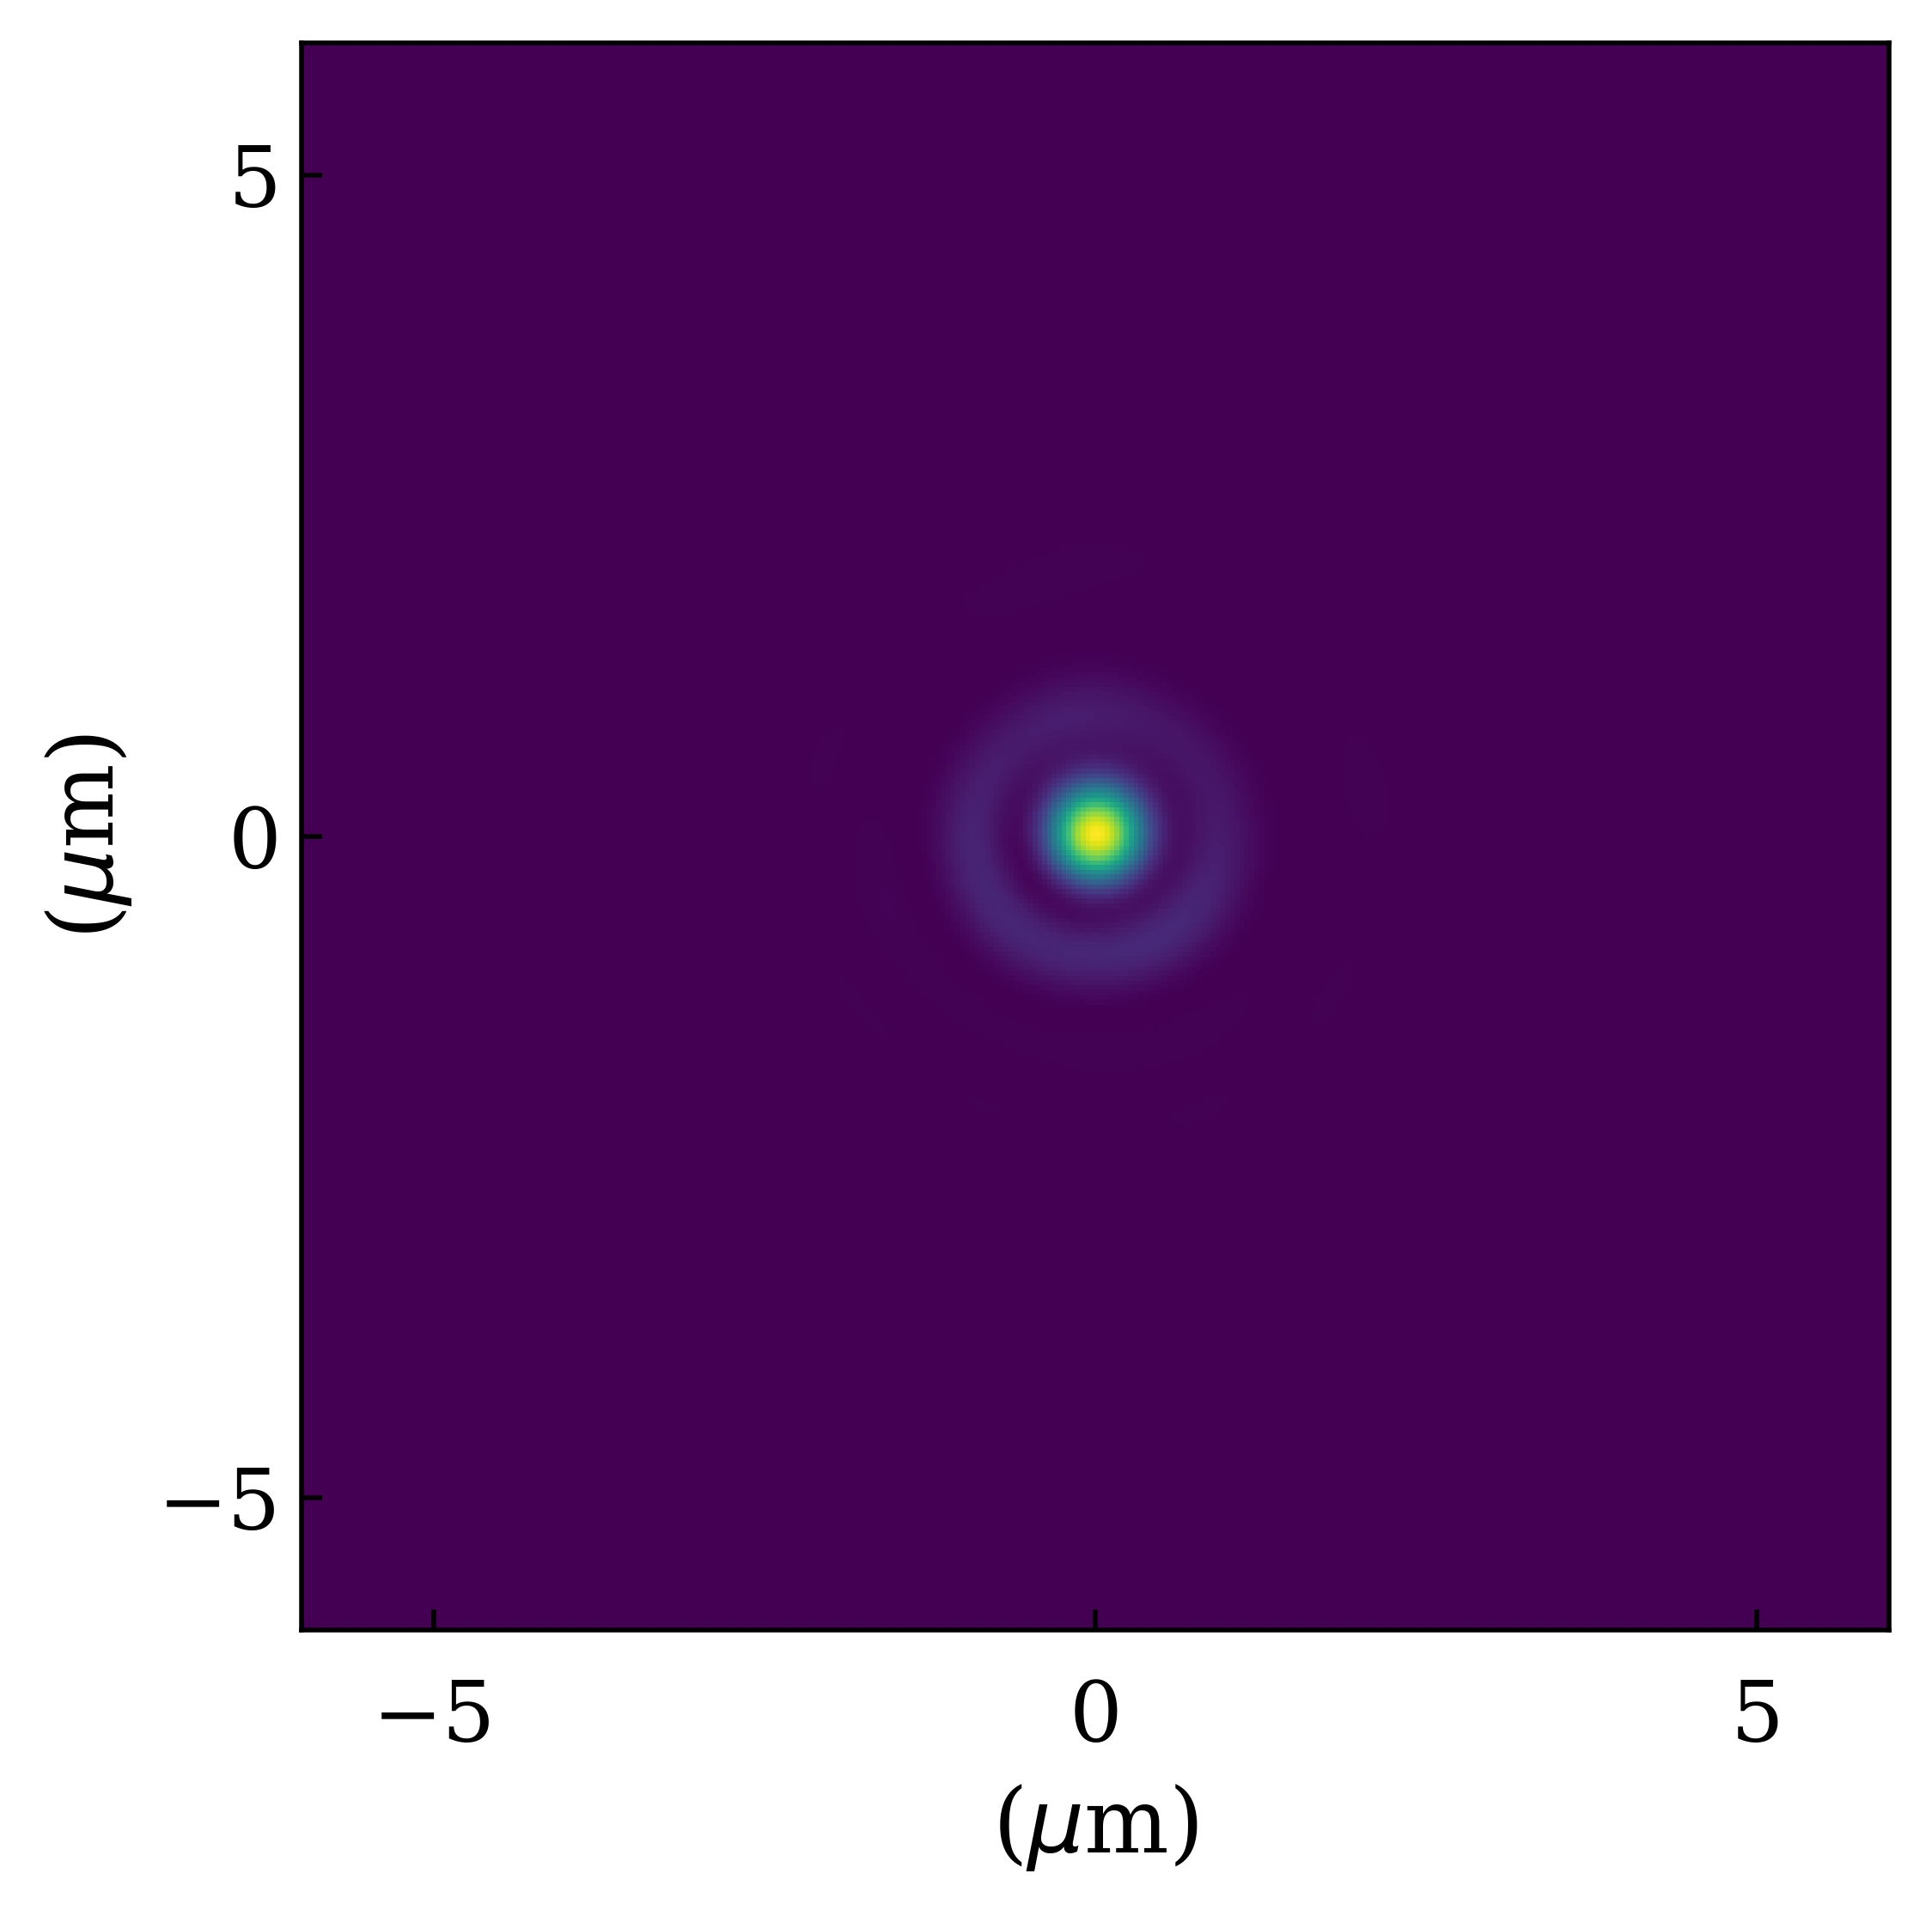
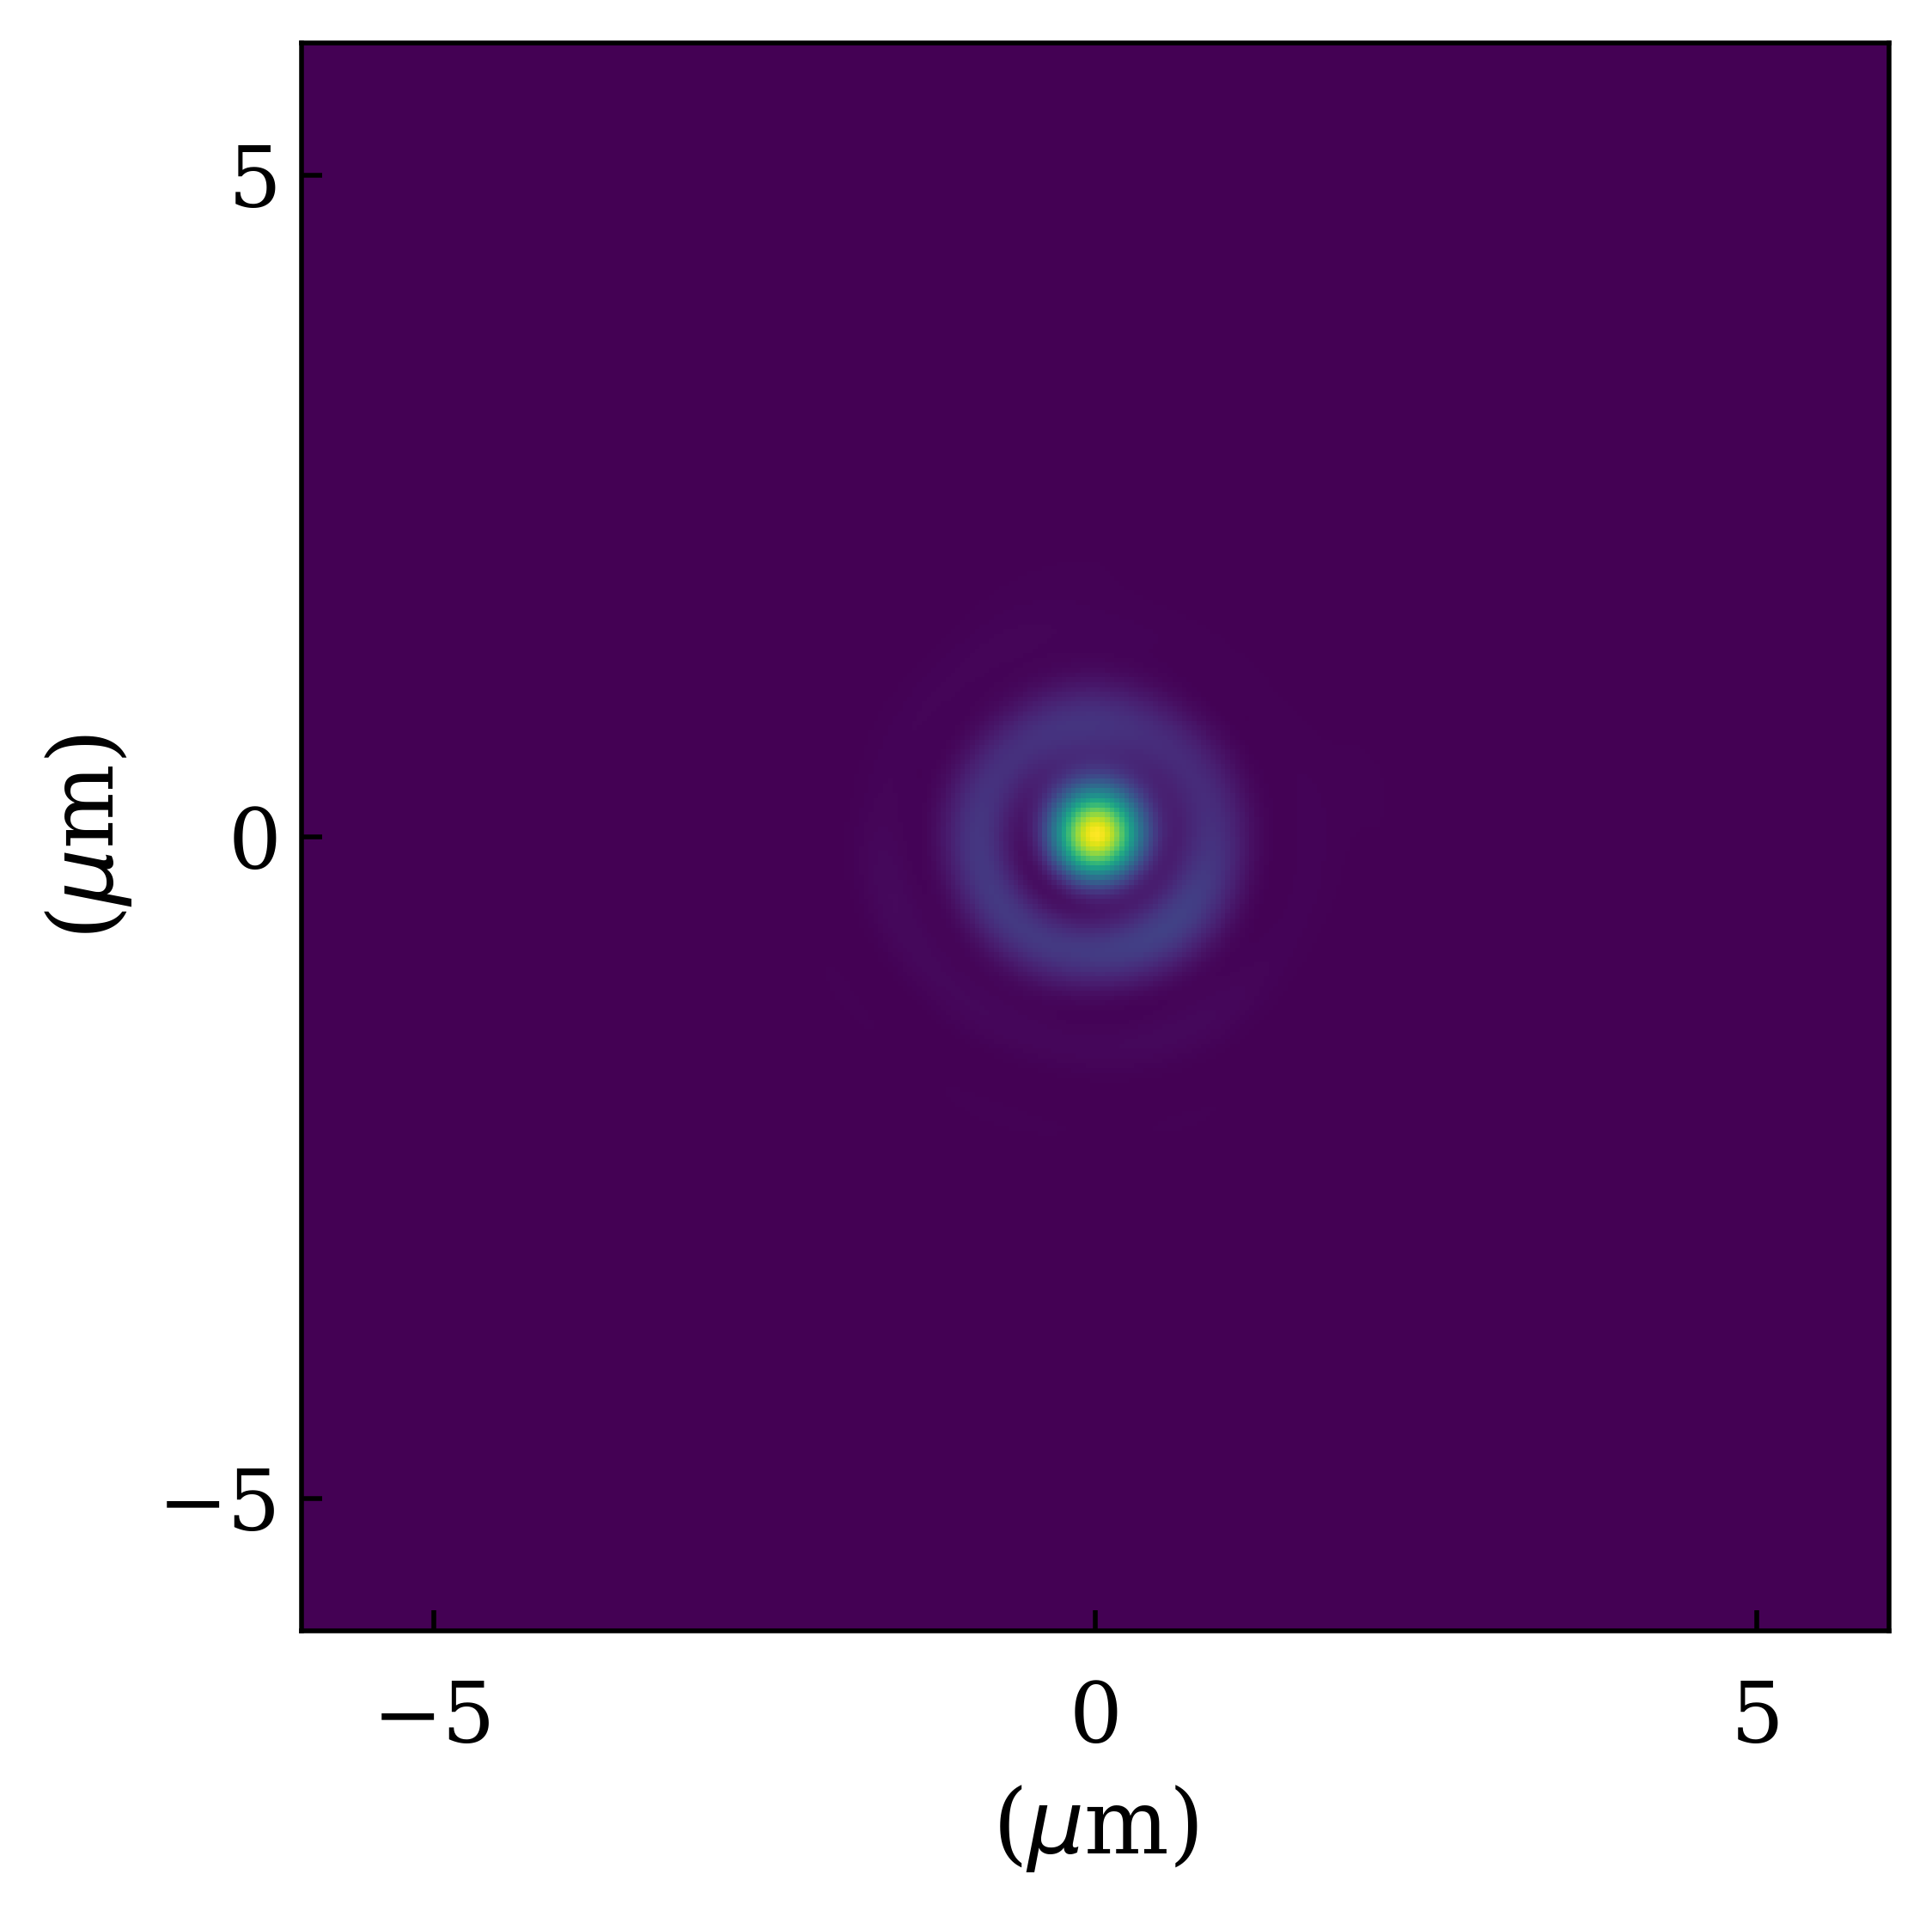
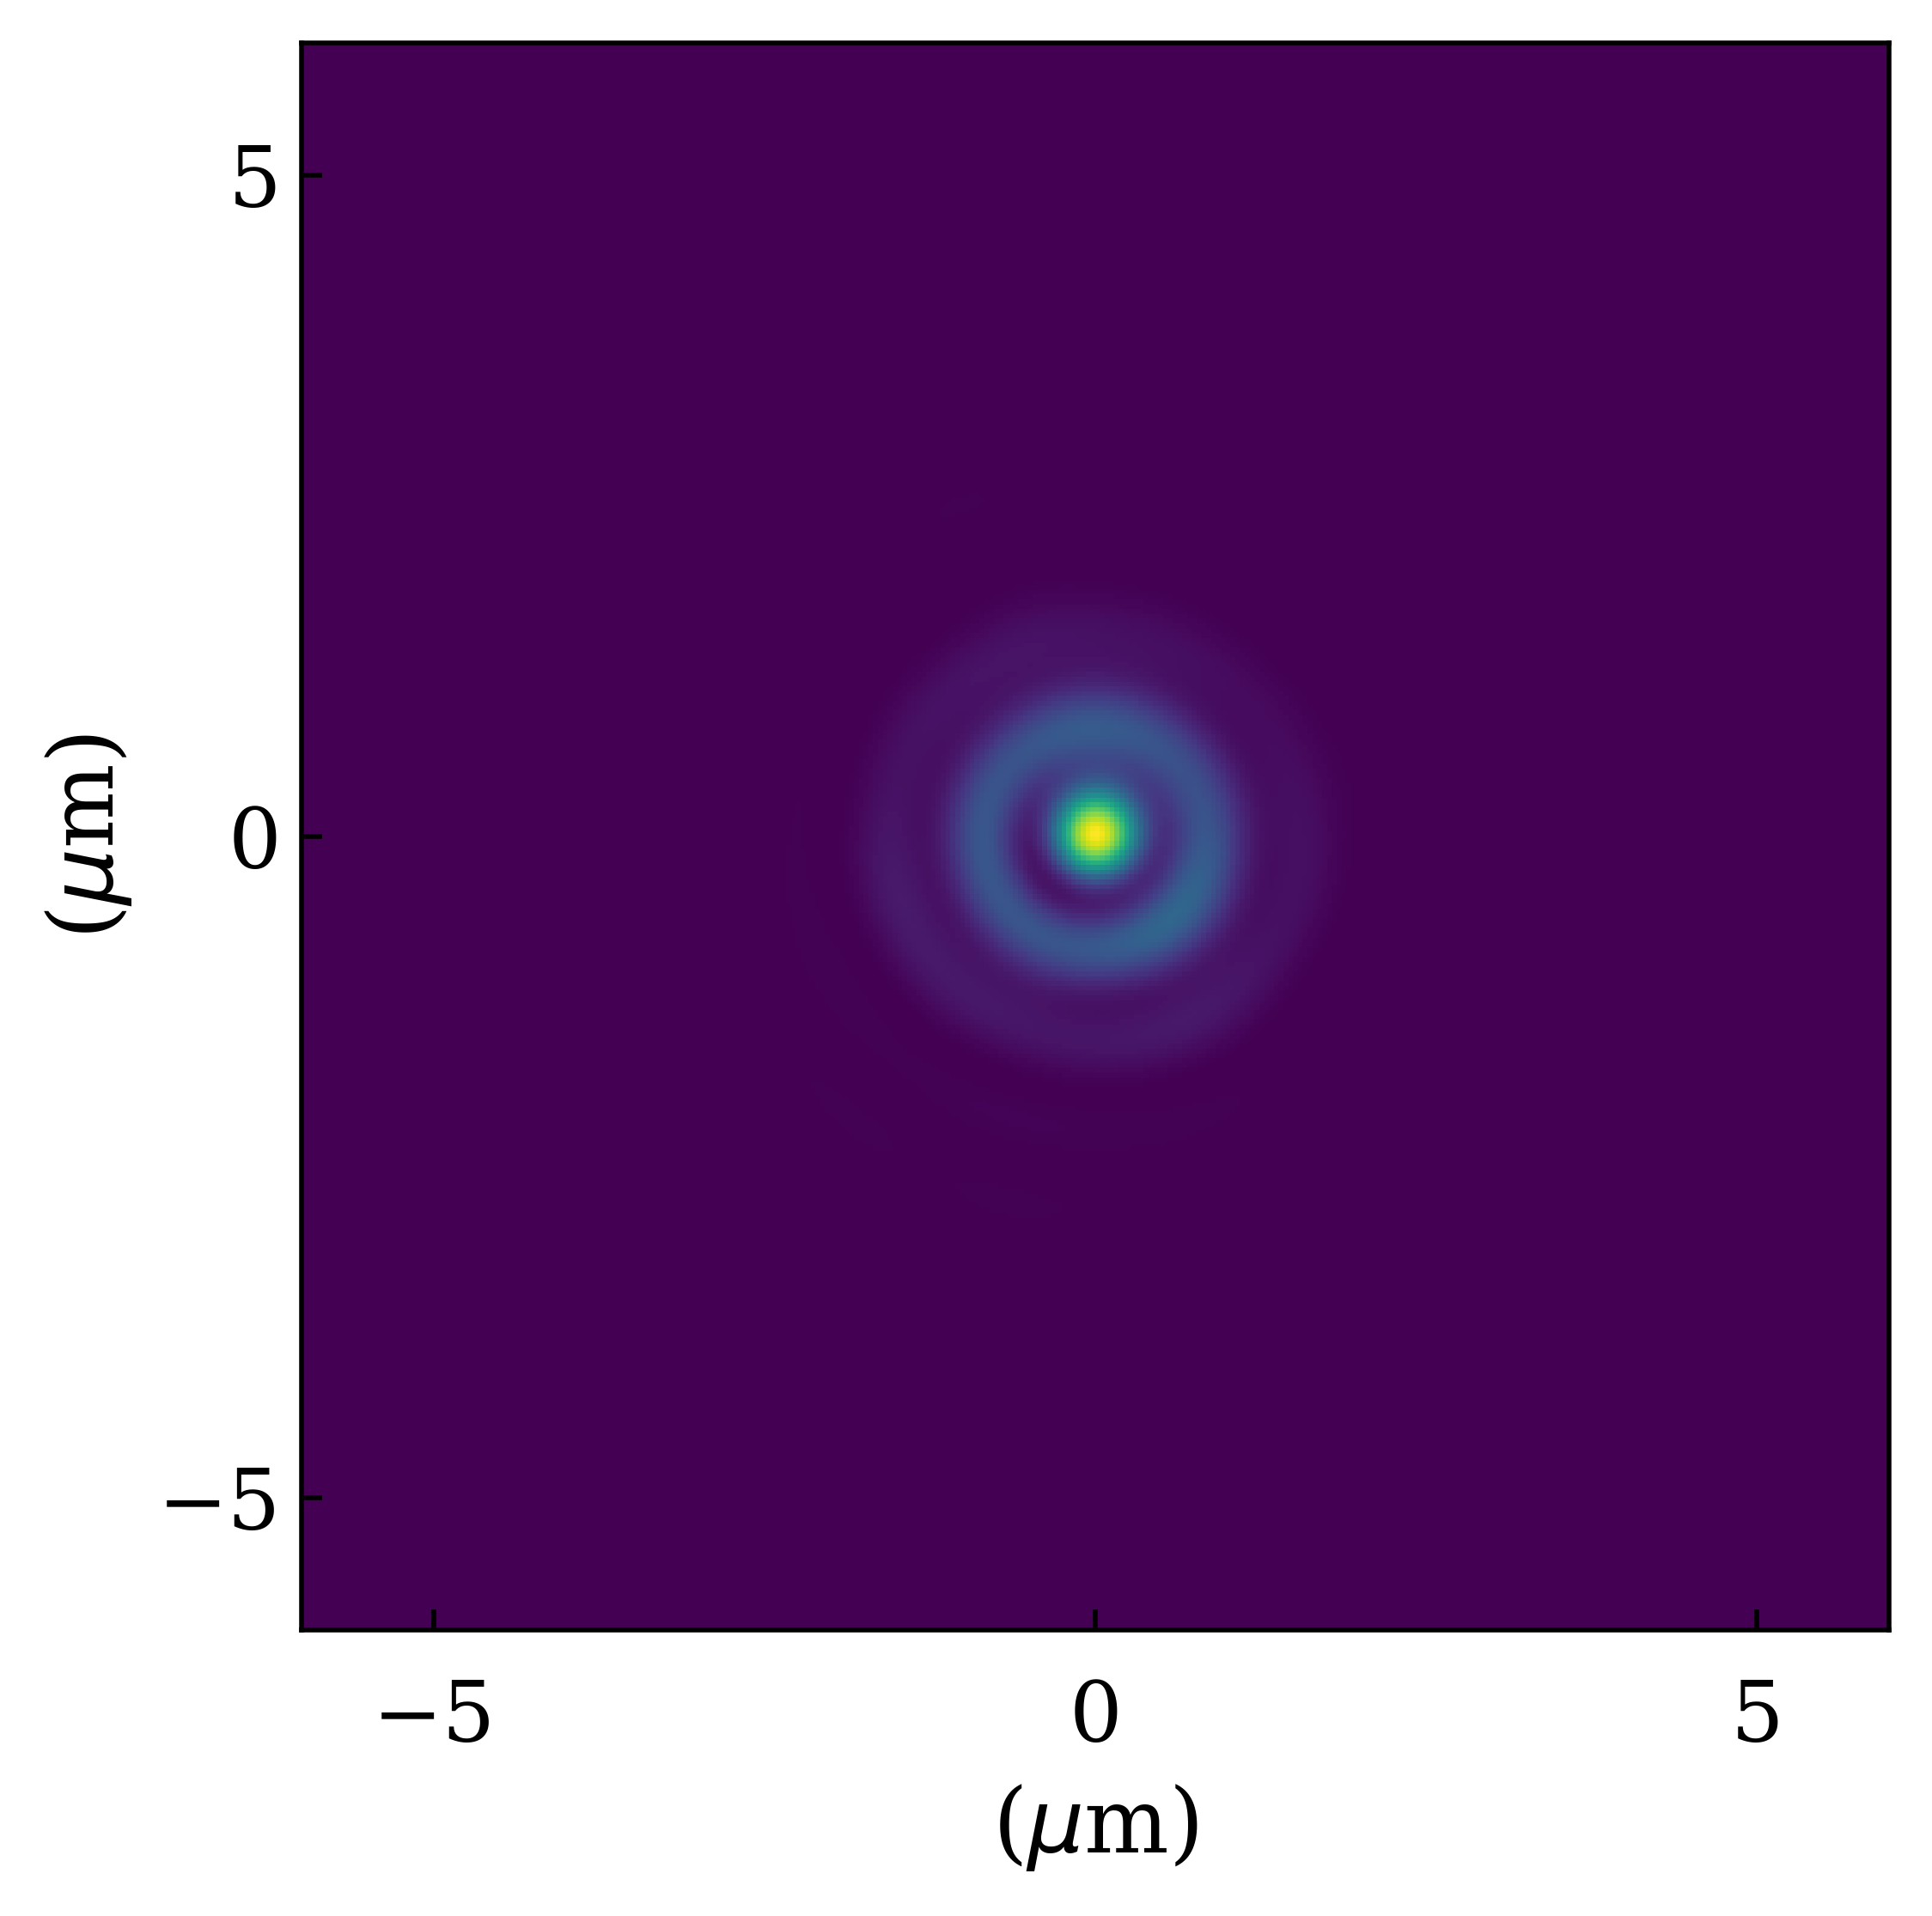
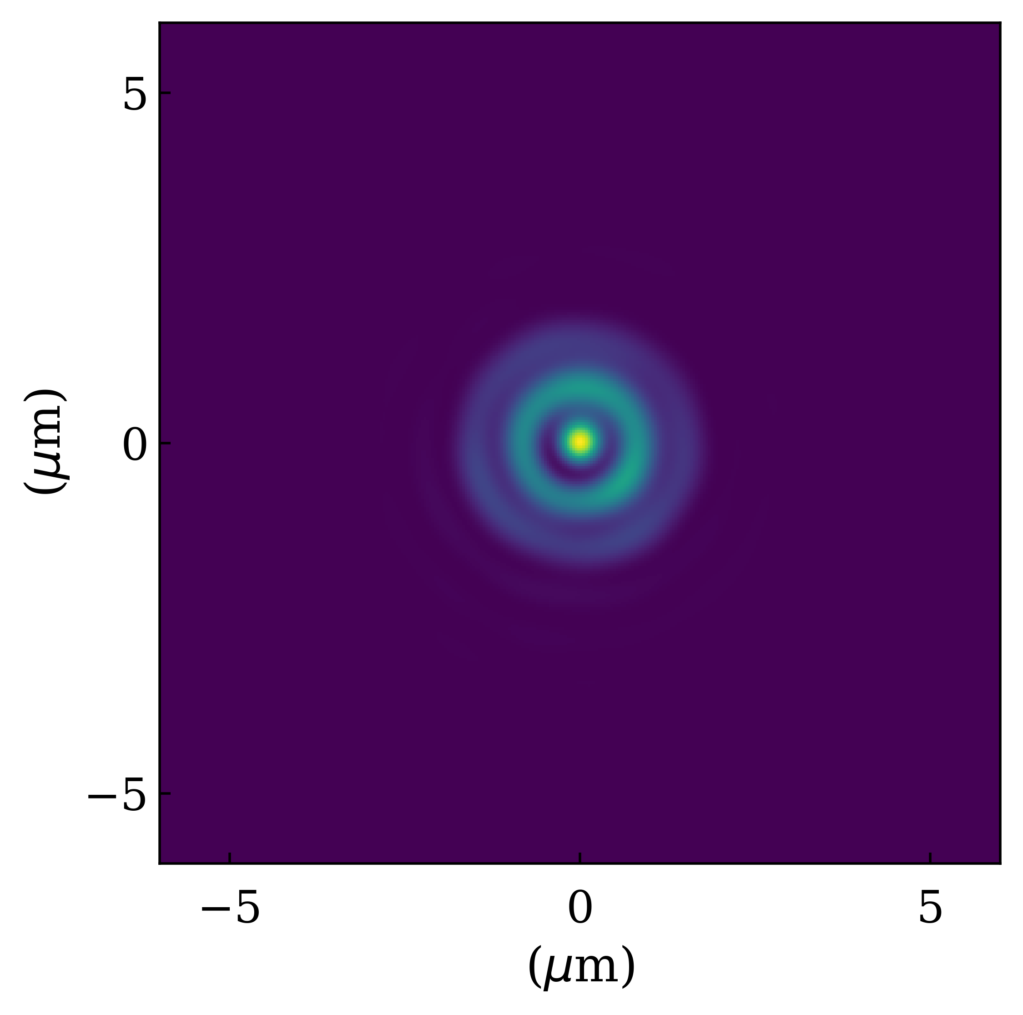
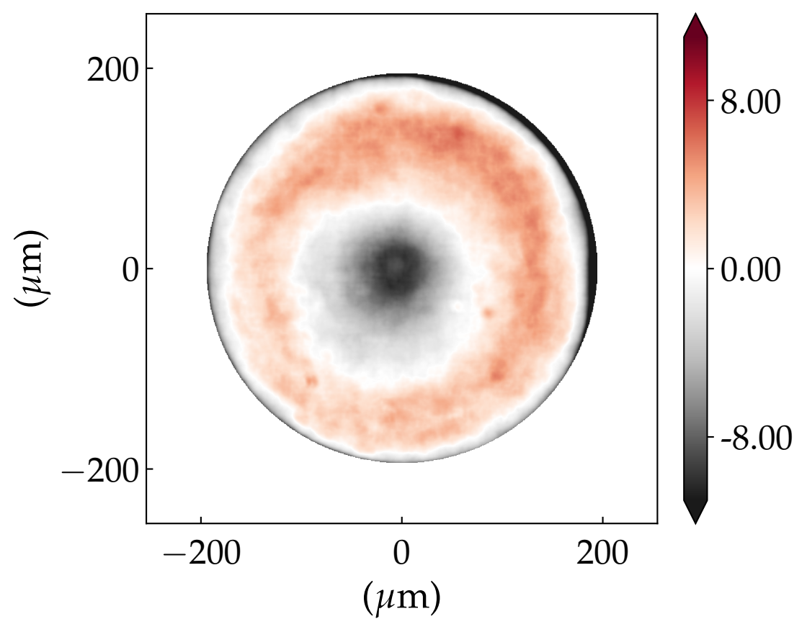
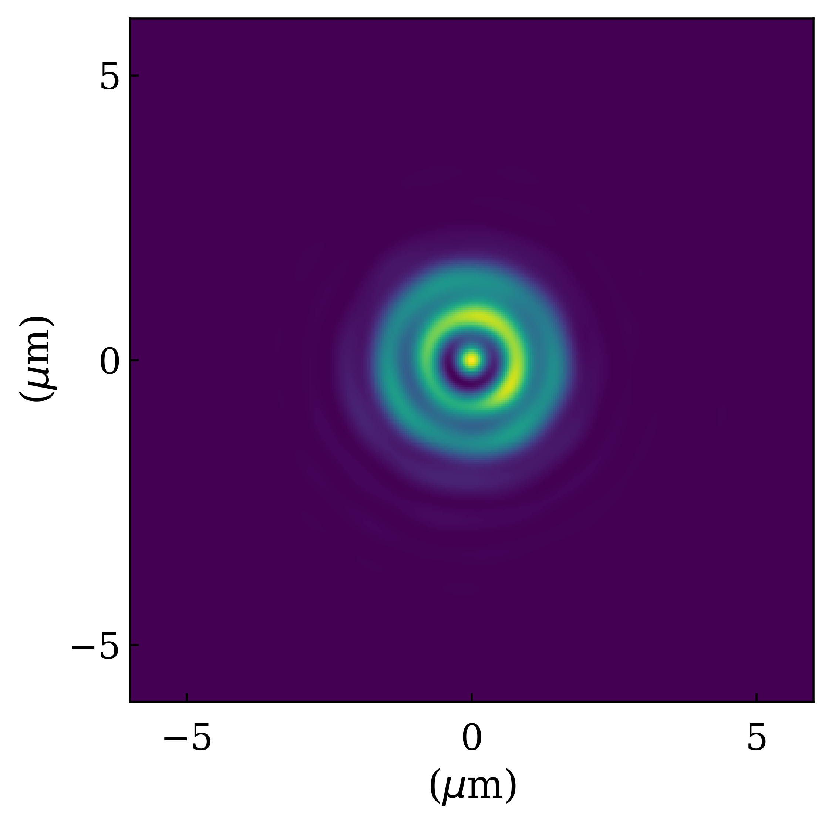
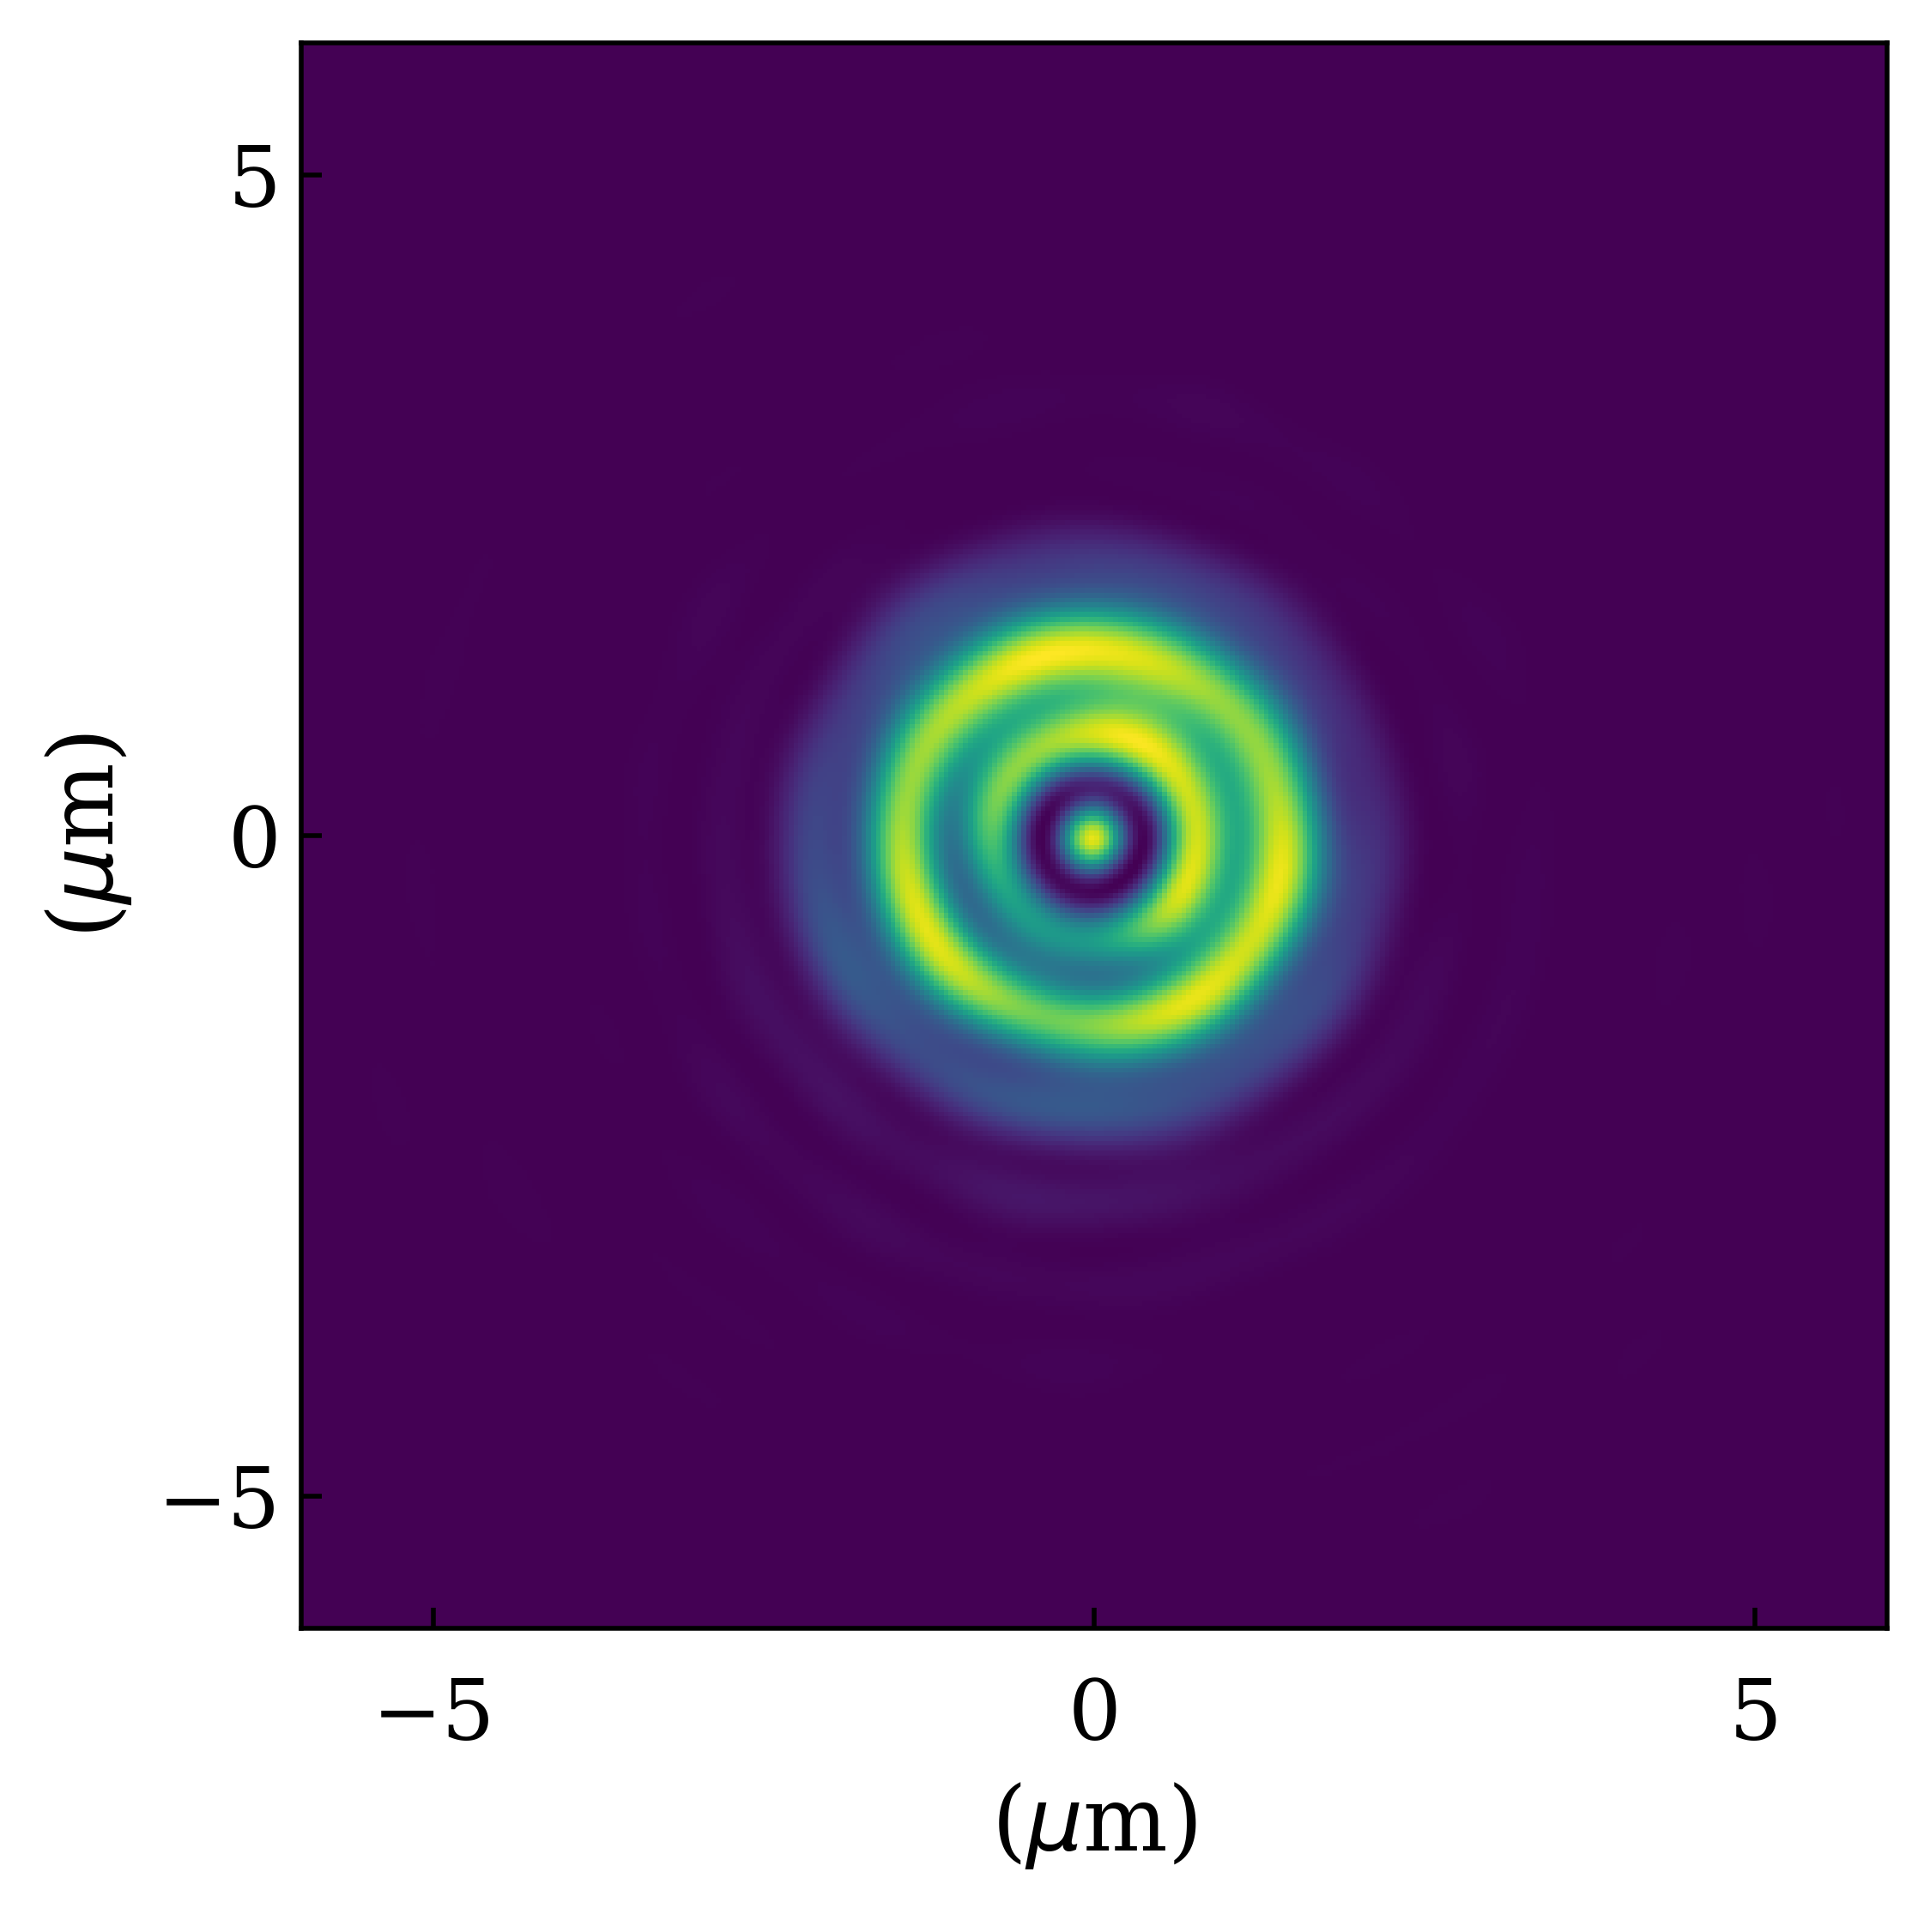
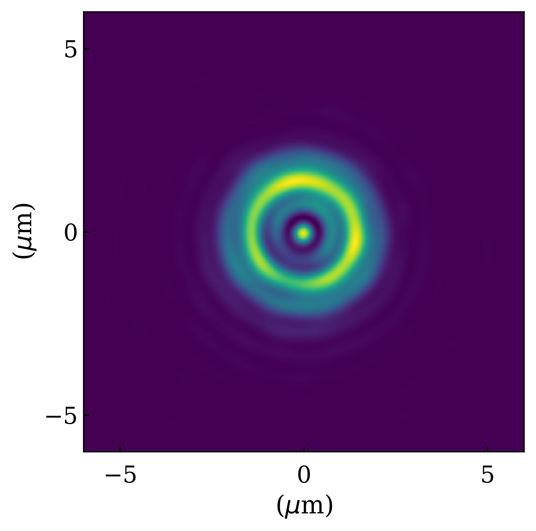



Accurate simulation of x-ray lenses and CRL - III
Coherent simulations of 4x 2D Be lens stack focusing:
Exp. data courtesy of E. Bellec & S. Leake (ESRF-ID01)
0 mm
3 mm
6 mm
9 mm
12 mm
15 mm
18 mm
21 mm
24 mm
27 mm
(b) ptychographic data reconstruction
0 mm
3 mm
6 mm
9 mm
12 mm
15 mm
18 mm
21 mm
24 mm
27 mm
(a) stack metrology
(c) simulations using SRW

Slide 12
Examples
Live demo using OASYS…

Slide 13
Thank you!

